Slide 1
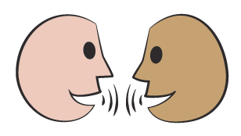
Add and subtract 0.1 and 1 to/from numbers with 1 decimal place.
0.1
0.2
0.3
0.4
0.5
0.6
0.7
0.8
0.9
1
The numbers in this grid go up in steps of 0.1 instead of steps of 1.
What number will be at the end of the row?
That’s one at the end … NOT zero point ten!
Let’s count along to find out…

Slide 2
Add and subtract 0.1 and 1 to/from numbers with 1 decimal place.
0.1
0.2
0.3
0.4
0.5
0.6
0.7
0.8
0.9
1
1.1
1.2
1.3
1.4
1.5
1.6
1.7
1.8
1.9
2
3
What will be the first 3 numbers in the next row?
Let’s count along to check.
On a 1–100 grid, when we move down the grid, we add 10. Going down, what do we add on this grid?
4
5
6
Let’s count down the right-hand (ones) column to check..
What will be at the end of the row?
7
What will be in the very last square of the grid?
8
9
10

Slide 3
Add and subtract 0.1 and 1 to/from numbers with 1 decimal place.
0.1
0.2
0.3
0.4
0.5
0.6
0.7
0.8
0.9
1
1.1
1.2
1.3
1.4
1.5
1.6
1.7
1.8
1.9
2
Let’s check...
2.4
2.5
2.6
3
3.5
3.8
4
4.2
2.5 + 0.1 = 2.6
5
What numbers are to the right, left and below 2.5? Write an addition or subtraction sentence to show how 2.5 is changed in each calculation.
6
What numbers would go in the highlighted squares? How can you find them?
2.5 - 0.1 = 2.4
7
2.5 + 1 = 3.5
7.9
8
9
10

