Slide 1
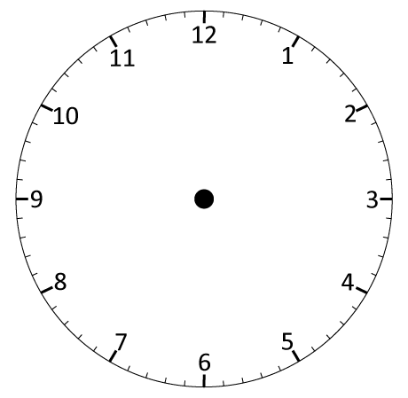



Write and draw corresponding analogue and digital clock times.
What time is the clock showing?
colon
9 o’clock.
9:00
Where will each hand be in half an hour?

Slide 2
Write and draw corresponding analogue and digital clock times.
Let’s see…
Half past 9.
9:30

Slide 3
Write and draw corresponding analogue and digital clock times.
Let’s count around the clock in 5 minute intervals…
colon
9:00
9:05
9:10
9:15
9:20
9:25
9:30

Slide 4

Write and draw corresponding analogue and digital clock times.
On a piece of paper, write the digital times equivalent to these analogue clocks.
10:00
1:05
11:10
5:15
8:20
7:25
2:30

