Slide 1

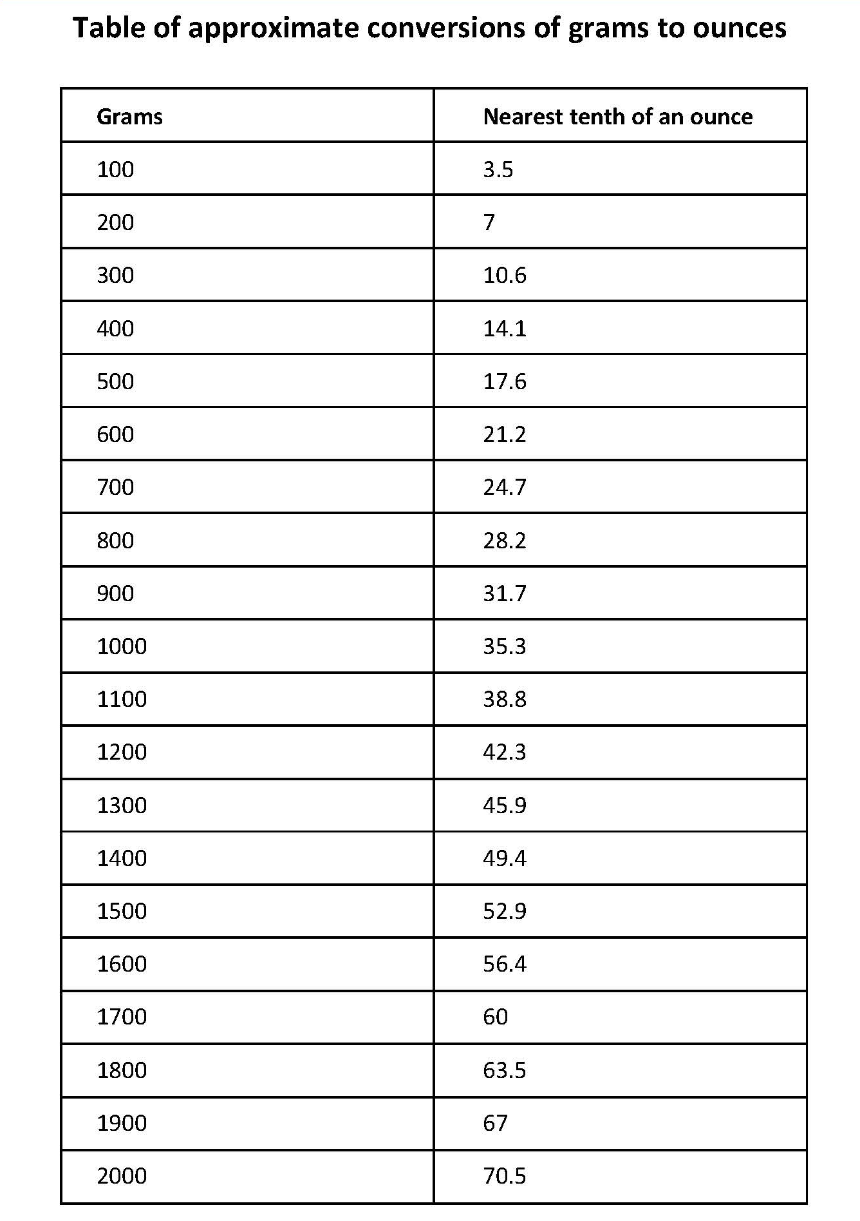

Draw a conversion graph for imperial to metric units; read equivalent measures.
Ounces are an imperial measure, still used sometimes in cooking, as are pounds (not money!)
People also often report babies’ weights in pounds. One pound is 16 ounces.
So, 67 ounces is
4 pounds and 3 ounces.
60 ÷ 16 = 3 r12
So, 60 ounces is
3 pounds and 12 ounces.
What is 60 ounces in pounds and ounces?
And 67 ounces in pounds and ounces?

Slide 2
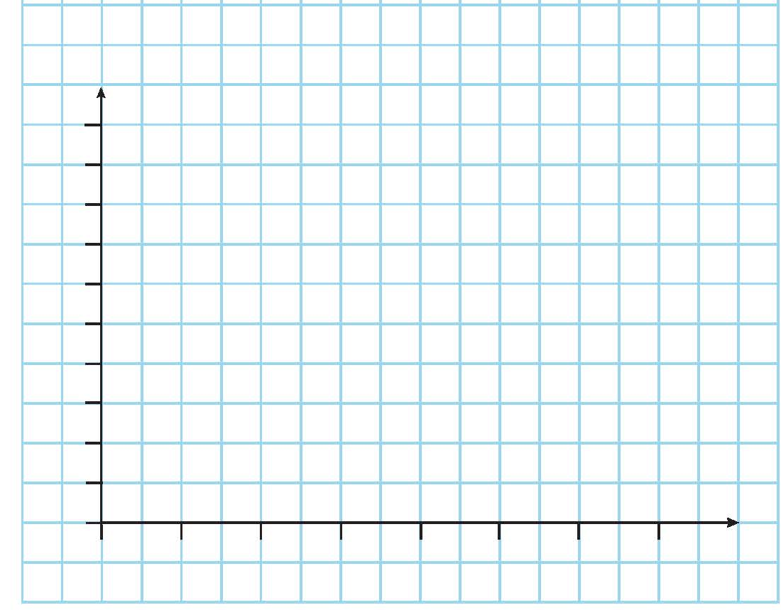
Draw a conversion graph for imperial to metric units; read equivalent measures.
In the table, 1.7kg was approximately equal to 60 ounces.
Check this on the graph.
In the table, 1kg was approximately equal to 35.3 ounces.
Check this on the graph.
2kg
1.8kg
1.6kg
1.4kg
1.2kg
1kg
0.8g
0.6g
0.4g
0.2g
0
+
Because the relationship between kilograms and ounces is always the same, the graph is a straight line, so we do not need to mark on all the other points.
Can you use the graph to estimate how many kilograms are the same as 100 ounces, even though 100 ounces is not on the graph?
+
We can double the number of kilograms which are equivalent to 50 ounces.
0
10oz
20oz
30oz
40oz
50oz
60oz
70oz

