Slide 1
Using conjunctions and prepositions to add information

Slide 2
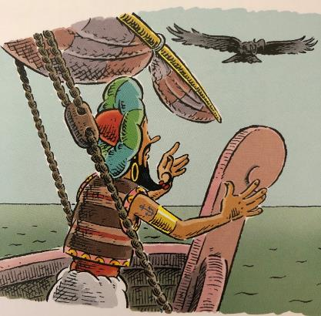
Clauses
Clauses are groups of words with an active verb and a subject.
Sinbad kept watch.
He looked all around.
Then he spotted the island in the distance.
He shouted loudly, excited to see it.
The subject is ‘the doer’ of the verb; it can be a noun or pronoun.
Revision

Slide 3
Sinbad kept watch.
Conjunctions
Conjunctions join clauses.
as
join clauses.
He spotted the island.
because
so
He shouted loudly.
before
He had adventures.
after
when
since
until
Sinbad kept watch because they needed food.
as
while
He shouted loudly when he spotted the island.
wherever
Wherever he went, he had adventures.
where
Remember – a clause always has an active verb.

Slide 4
Conjunctions
Conjunctions help us express time, place and cause.
Sinbad kept watch…
while the other men worked.
When?
Sinbad kept watch…
after they had travelled for days.
Sinbad kept watch…
when he was hoping for land.
Spot the active verb in each clause.
Try adding your own clause to express time.

Slide 5
Conjunctions
Conjunctions help us express time, place and cause.
He spotted the island…
where he had been looking.
Where?
He spotted the island…
where the sky met the sea.
He spotted the island…
where the bird had flown from.
Wherever is useful for more general statements.
He has adventures wherever he goes.
He finds new treasure wherever he lands.
The bird followed wherever the ship sailed.
Spot the active verb in each clause.
Try adding your own clause to express place.

Slide 6
Conjunctions
Conjunctions help us express time, place and cause.
He shouted loudly…
because he was excited.
Why?
He shouted loudly …
since he wanted everyone to hear.
Why?
He shouted loudly…
as he hoped they would eat soon!
Why?
Spot the active verb in each clause.
Try adding your own clause to express cause.

Slide 7
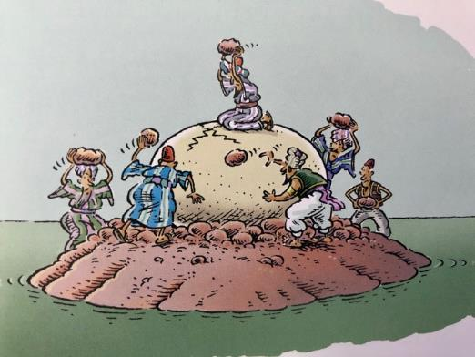
Phrases
A phrase is a group of words which adds meaning to a sentence.
on the island
with a massive rock
in the sea
because of the hunger
There is no active verb in a phrase.
Revision

Slide 8
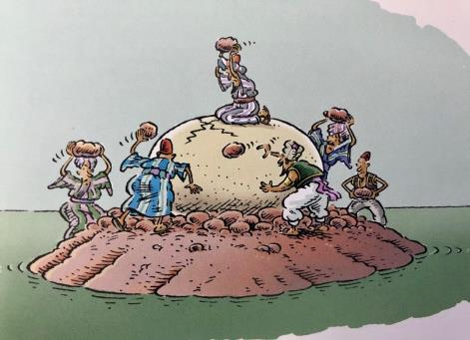
Prepositions
Prepositions link a phrase to a clause.
There must be a door
in here somewhere!
with this rock.
I will hit it
A crack opened up
in the middle of the egg.
under
outside
from
due to
inside
above
while
on
because of
on
from
below
during
since
over
at
after
for
in
before
between

Slide 9
Prepositions
Prepositions help us express time, place and cause.
time
, place
and cause.
When?
Sinbad spotted the island
at dawn.
The men struggled
during the afternoon.
The bird arrived
after the feasting.
Prepositions
while, since,
before, during, after, at, on
Try adding your own prepositional phrase to express time.

Slide 10
Prepositions
Prepositions help us express time, place and cause.
time,
place
and cause.
Where?
The man balanced
on top of the egg.
The bird flew
above the men.
They found delicious yolk
in the middle of the egg.
Prepositions
above, below,
inside, outside, on, in, between
Try adding your own prepositional phrase to express place.

Slide 11
Prepositions
Prepositions help us express time, place and cause.
time,
place and
cause.
How?
The men threw rocks
in a wild effort.
They were desperate
due to their deep hunger.
Why?
They were at risk
because the bird was near.
Why?
Prepositions
because of, due to,
from, for
Try adding your own prepositional phrase to express cause.

Slide 12
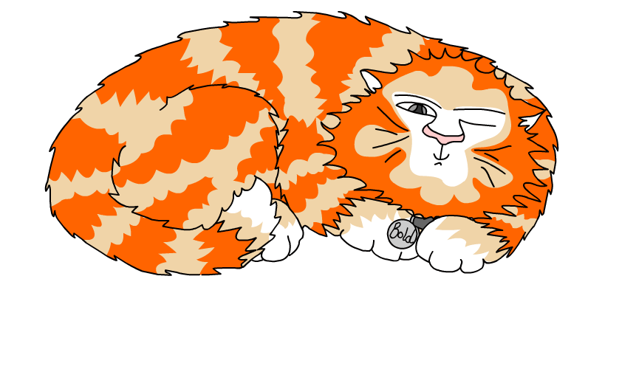
Explore more Hamilton Trust Learning Materials at https://wrht.org.uk/hamilton/ .

