Slide 1
Pentecost and Mission
An impossible task?

Slide 2
Have you ever been asked to do something that you just don’t know how to do? How did it make you feel? You might ask questions like, “Why choose me?” or “Where do I start?” or “How am I supposed to do that?” At his ascension, Jesus gave the disciples a huge mission (or task). Read about it on the next slide …

Slide 3
Matthew 28 – The Great Commission
Then the eleven disciples went to Galilee, to the mountain where Jesus had told them to go. When they saw him, they worshiped him; but some doubted. Then Jesus came to them and said, “All authority in heaven and on earth has been given to me. Therefore go and make disciples of all nations, baptizing them in the name of the Father and of the Son and of the Holy Spirit, and teaching them to obey everything I have commanded you. And surely I am with you always, to the very end of the age.”

Slide 4
How were the disciples going to obey this command?
How were the disciples going to convince people to follow someone who they had seen crucified?
How were going to get to “all nations”?
How were they going to teach all people everywhere when many of the disciples were just simple fishermen?

Slide 5
Jesus sends help …
When the day of Pentecost came, they were all together in one place. Suddenly a sound like the blowing of a violent wind came from heaven and filled the whole house where they were sitting. They saw what seemed to be tongues of fire that separated and came to rest on each of them. All of them were filled with the Holy Spirit and began to speak in other tongues as the Spirit enabled them.
Now there were staying in Jerusalem God-fearing Jews from every nation under heaven. When they heard this sound, a crowd came together in bewilderment, because each one heard their own language being spoken. Utterly amazed, they asked: “Aren’t all these who are speaking Galileans? Then how is it that each of us hears them in our native language?

Slide 6
Does this answer any of our questions?
How were the disciples going to convince people to follow someone who they had seen crucified?
How were going to get to “all nations”?
How were they going to teach all people everywhere when many of the disciples were just simple fishermen?

Slide 7
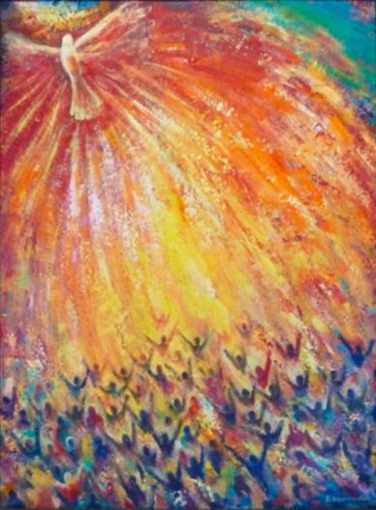
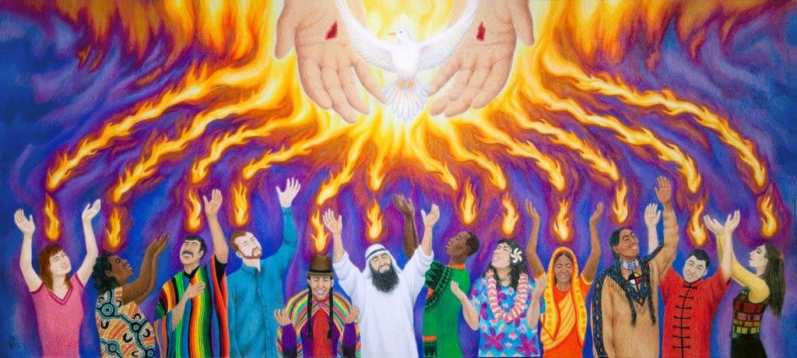
Pentecost inspired art

Slide 8
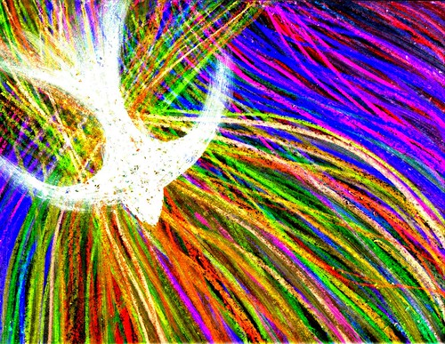
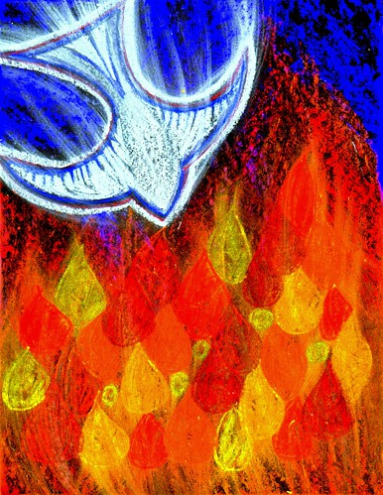
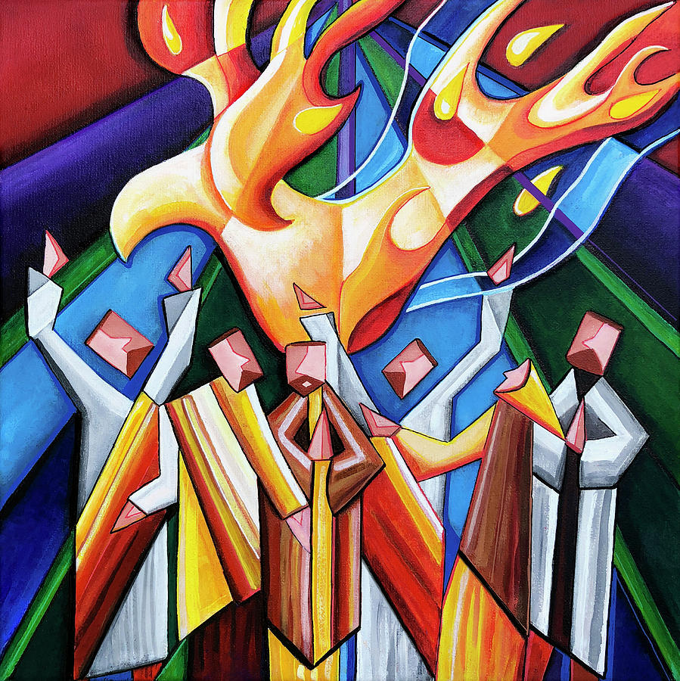

Slide 9
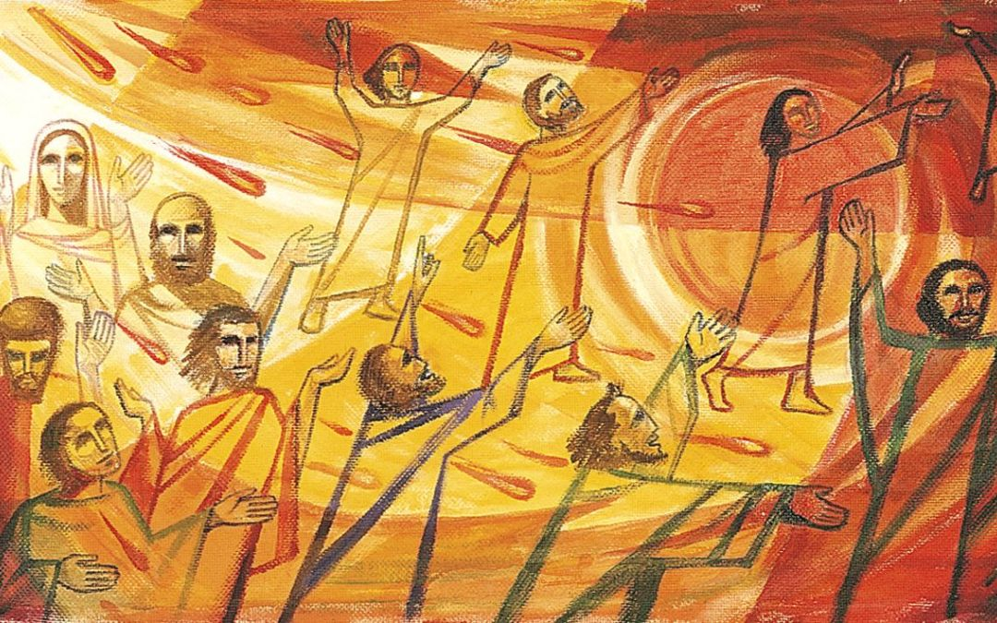

Slide 10
Your task:
Have a go at creating your own Holy Spirit inspired art! Think about how the artists have used …
colour to represent emotion
texture to show movement and energy
You can choose your medium (paint, pastels, colouring pencils) or even create a 3D piece of art! It would be lovely if we could display some of these in school and on the website – so send your images to admin@stjo.uk with permission to put on school website / facebook page.
Thank you!

