Slide 1
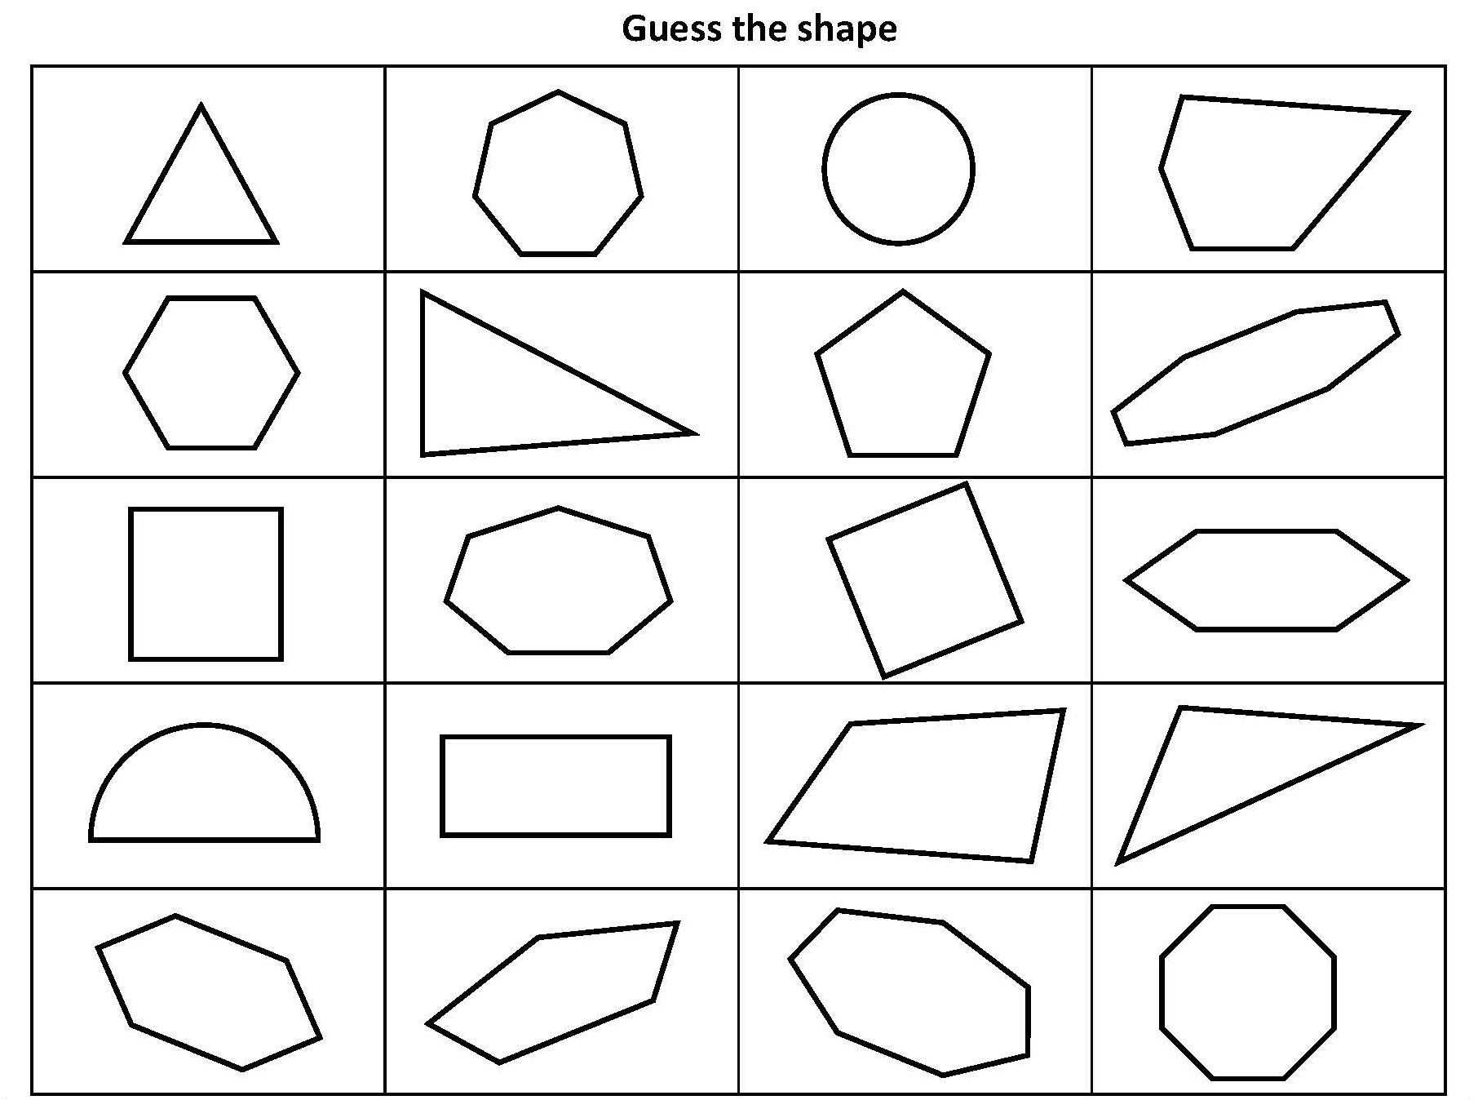
Describe properties of 2-D shapes including polygons.
Note how most of the shapes are polygons. Shapes with all straight sides are called polygons. Circles, ovals and semicircles are not polygons even though they are 2-D shapes.

Slide 2
Describe properties of 2-D shapes including polygons.
polygon
regular/irregular
number of vertices
number of sides
right/obtuse/acute angles
lines of symmetry
Some useful vocabulary for describing shapes. This will help you with today’s activities.
Regular shapes have all sides the same length and all angles the same size. Irregular shapes do not!
Vertices are the corners of 2-D shapes.
A right angle measures exactly 90°.
An acute angle measures between 0 and 90°.
An obtuse angle measures between 90° and 180°.
A shape has symmetry if it can be divided into two parts that are mirror images.

Slide 3
Describe properties of 2-D shapes including polygons.
I am thinking of a shape. It has 4 sides and no lines of symmetry, which shape is it?
This shape has 3 vertices and 1 obtuse angle, which one is it?
This shape has 6 vertices and all the sides are the same length. Which one is it?
This shape is an irregular polygon with 5 sides, can you spot both of them?
This shape is not a polygon and has one line of symmetry. Can you find it?
Now make up some clues for identifying the other shapes! Try them out with an adult, can they figure them out?

