Slide 1
Pentecost and Mission
An impossible task?

Slide 2
Have you ever been asked to do something that you just don’t know how to do?
How did it make you feel?
You might ask questions like, “Why choose me?” or “Where do I start?” or “How am I supposed to do that?”
At his ascension, Jesus gave the disciples a huge mission (or task). Read about it on the next slide …

Slide 3
Matthew 28 – The Great Commission
Then the eleven disciples went to Galilee, to the mountain where Jesus had told them to go. When they saw him, they worshiped him; but some doubted. Then Jesus came to them and said, “All authority in heaven and on earth has been given to me. Therefore go and make disciples of all nations, baptizing them in the name of the Father and of the Son and of the Holy Spirit, and teaching them to obey everything I have commanded you. And surely I am with you always, to the very end of the age.”

Slide 4
How were the disciples going to obey this command?
How were the disciples going to convince people to follow someone who they had seen crucified?
How were going to get to “all nations”?
How were they going to teach all people everywhere when many of the disciples were just simple fishermen?

Slide 5
Jesus sends help …
When the day of Pentecost came, they were all together in one place. Suddenly a sound like the blowing of a violent wind came from heaven and filled the whole house where they were sitting. They saw what seemed to be tongues of fire that separated and came to rest on each of them. All of them were filled with the Holy Spirit and began to speak in other tongues as the Spirit enabled them.
Now there were staying in Jerusalem God-fearing Jews from every nation under heaven. When they heard this sound, a crowd came together in bewilderment, because each one heard their own language being spoken. Utterly amazed, they asked: “Aren’t all these who are speaking Galileans? Then how is it that each of us hears them in our native language?

Slide 6
Does this answer any of our questions?
How were the disciples going to convince people to follow someone who they had seen crucified?
How were going to get to “all nations”?
How were they going to teach all people everywhere when many of the disciples were just simple fishermen?

Slide 7
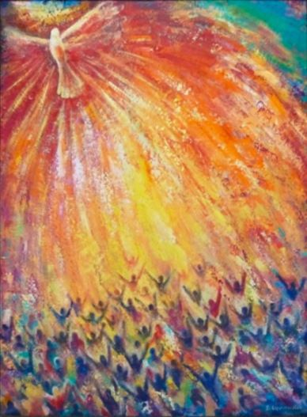
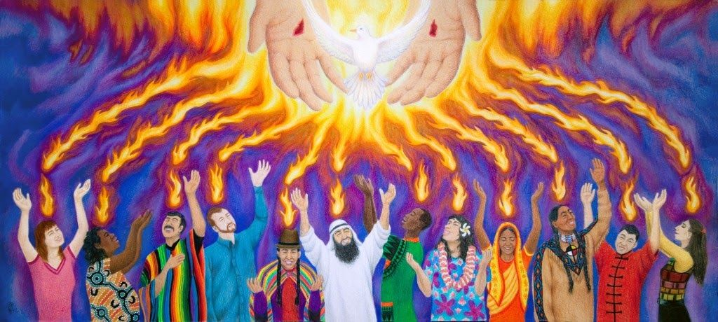
Pentecost inspired art

Slide 8
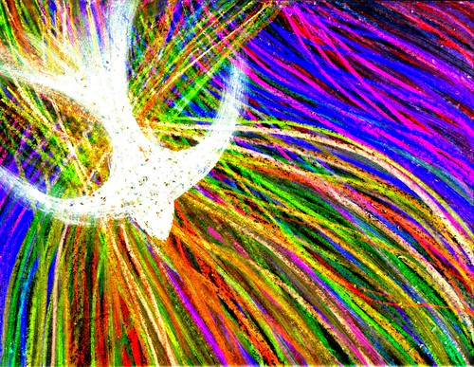
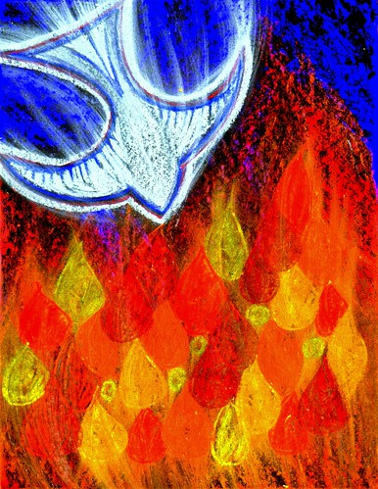
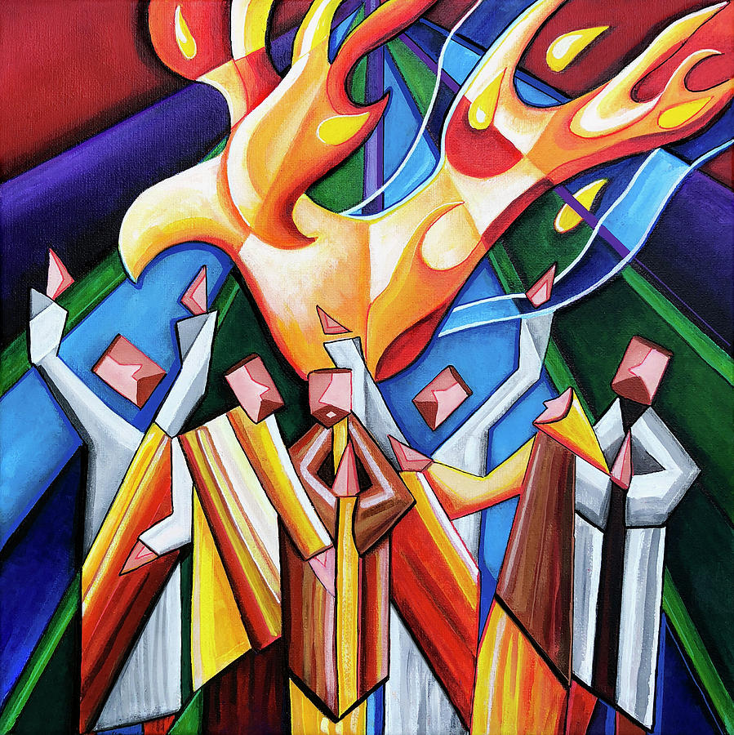

Slide 9
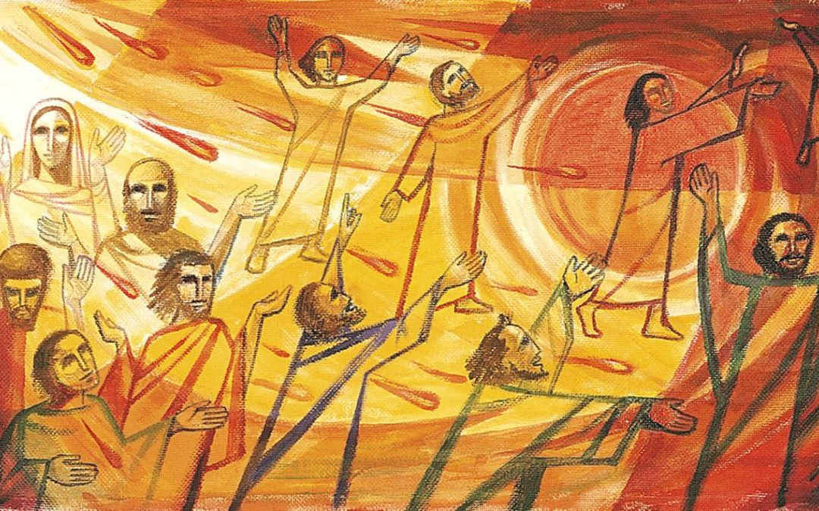

Slide 10
Your task:
Have a go at creating your own Holy Spirit inspired art! Think about how the artists have used …
colour to represent emotion
texture to show movement and energy
You can choose your medium (paint, pastels, colouring pencils) or even create a 3D piece of art! It would be lovely if we could display some of these in school and on the website – so send your images to admin@stjo.uk with permission to put on school website / facebook page.
Thank you!

Slide 11
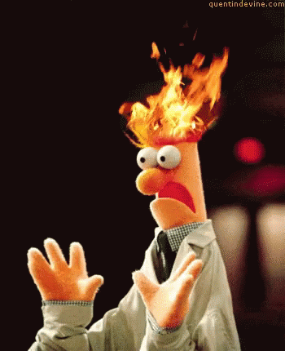
The Holy Spirit brings energy to all life
What does it mean when people say, “You’re on FIRE today?”
Think about the things that give you energy; we’re all different, so what is true for you, might not be for someone else. For example, these things give me energy:
Being out in nature
Spending time with friends
But others might find that they get energy from:
Spending time alone, reading or just being quiet
Watching a good movie
The disciples received energy for mission when they were filled with the Holy Spirit. We read about this just before half term. You can find the story on slide 5 of this powerpoint.

Slide 12

The Holy Spirit through the Bible
The Holy Spirit is mentioned throughout the bible. Right at the beginning, in Genesis, it says:
“In the beginning God created the heavens and the earth. Now the earth was formless and empty, darkness was over the surface of the deep, and the Spirit of God was hovering over the waters.”
“Then the Lord God formed a man from the dust of the ground and breathed into his nostrils the breath of life, and the man became a living being.”
The Holy Spirit was there, right at the beginning, breathing life and energy into creation.

Slide 13
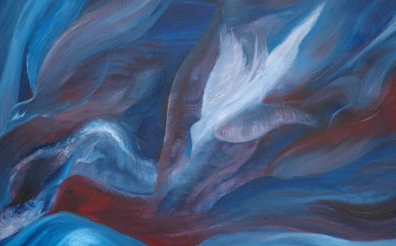
Ruach – breath or wind
In Hebrew – the language of the bible – Ruach means breath or wind. This is how Jesus described the Holy Spirit. There’s no mistake in his meaning – without breath, we cannot live!

Slide 14
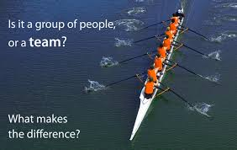
The Holy Spirit brings oneness

Slide 15
Talk to someone about these questions …
What makes a good team?
Does everyone have to do the same thing to work well?
Can you think of a situation where everyone has a specific job to make the team work?
How does it feel when you work together with a group of people to achieve something?

Slide 16
Oneness at Pentecost
When the Holy Spirit filled the disciples at Pentecost, not only did they receive the energy they needed to act, but they were helped to work together to fulfil the command Jesus had given them – to go out into all the world and tell people about him.
They became a team.
This team worked, with the help and energy of the Holy Spirit, and together saw the birth of the church (this is what is celebrated at Pentecost, also known as the birthday of the church).
The church still today works to bring God’s love to every corner of our planet – this is the mission Jesus gave us. We can be involved too.

Slide 17
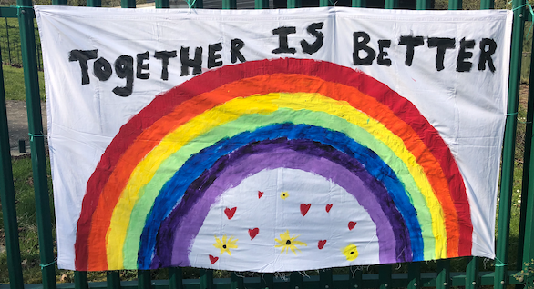
Being kind, sharing hope
During these strange and uncertain times, it is more important than ever that we are beacons of light in our community! We can show God’s love through our kind actions and by reminding people that there is hope – the rainbow is a sign of God’s faithfulness and mercy.
Is there someone you know of that needs reminding of God’s love?
How can you bring some kindness and hope to them? Make them a card, leave a gift on their door step? Call them for a chat?
You’ll be amazed at the difference a small act of kindness can make!

