Slide 1

REGREEN
THE DESERT
Can you come up with an ingenious solution to help families in Sudan overcome climate change and turn the desert green?
Notes:
Introduce the challenge.
Explain that pupils will be using their STEM skills to try and solve a problem faced by
communities in a country in a very different part of the world.
We are going to be asking them to find a way to overcome climate change in country that is already really suffering from the impact of climate change including deforestation, drought and flash floods.

Slide 2
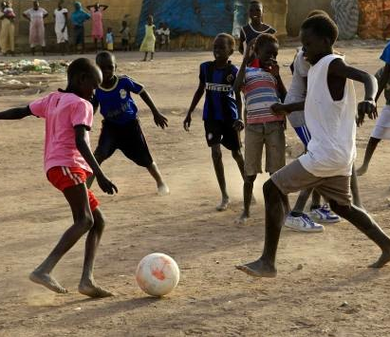

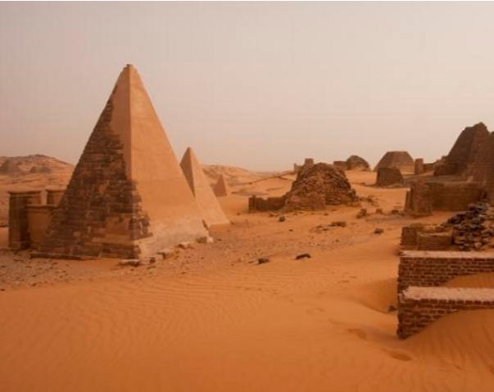
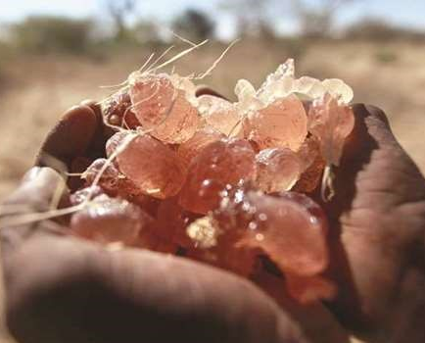
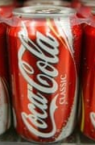


Sudan
Do you know what the Sudanese flag looks like?
Here are some other facts about Sudan.
2
2
Notes:
The country they are going to be focusing on is Sudan. Ask pupils if they already know anything about Sudan.
The country they are going to be focusing on is Sudan. Ask pupils if they already know anything about Sudan then show the slide.
• Sudan is the world’s largest producer of gum arabic. This is a natural resin which comes from acacia trees. The gum can be used as a glue on stamps or in inks and paints. But it is most valued for its use in foods such as sweets and fizzy drinks
.• Football and athletics are the most popular sports.• The official language of Sudan is Arabic but there are over 400 languages and dialects spoken
.• Most popular tourist attraction is the Pyramids of Meroe, build in 500BC. Very different shape to pyramids in neighbouring Egypt
.• Sudan is a country that suffers from conflict
.• Sudan split into two countries in 2011, Sudan and South Sudan after the south voted for independence
- Much of Sudan has been badly affected by climate change…in particular deforestation and drought.

Slide 3
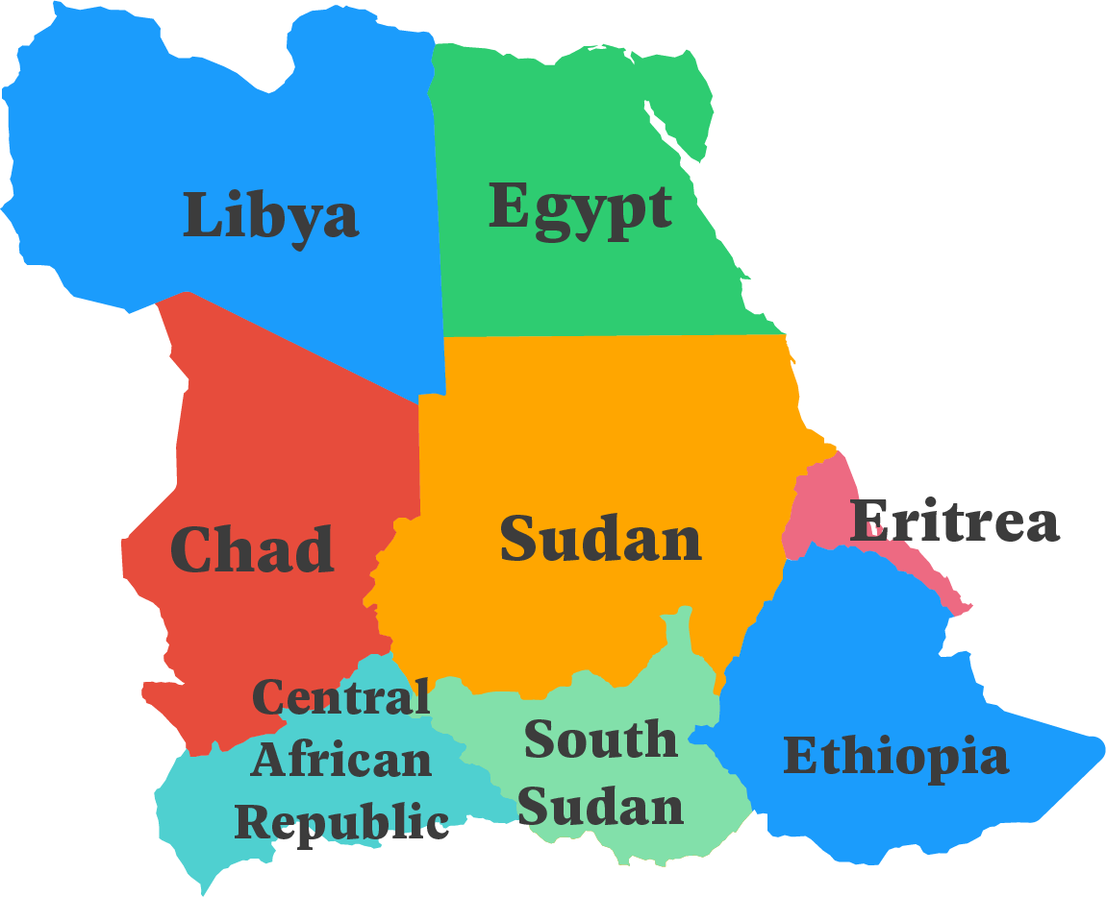
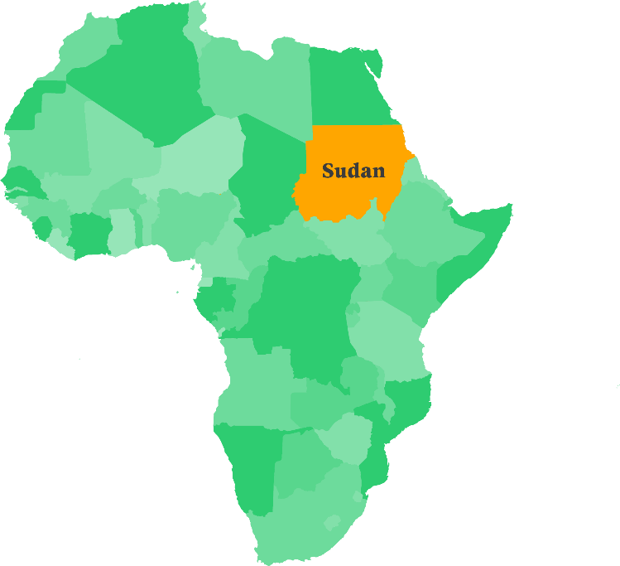
Where is Sudan?
3
Notes:
Before showing the first map ask students if they can point out Sudan on a globe or a world map that you have in your classroom.
Before showing the second map ask them if they can name any countries that border Sudan

Slide 4
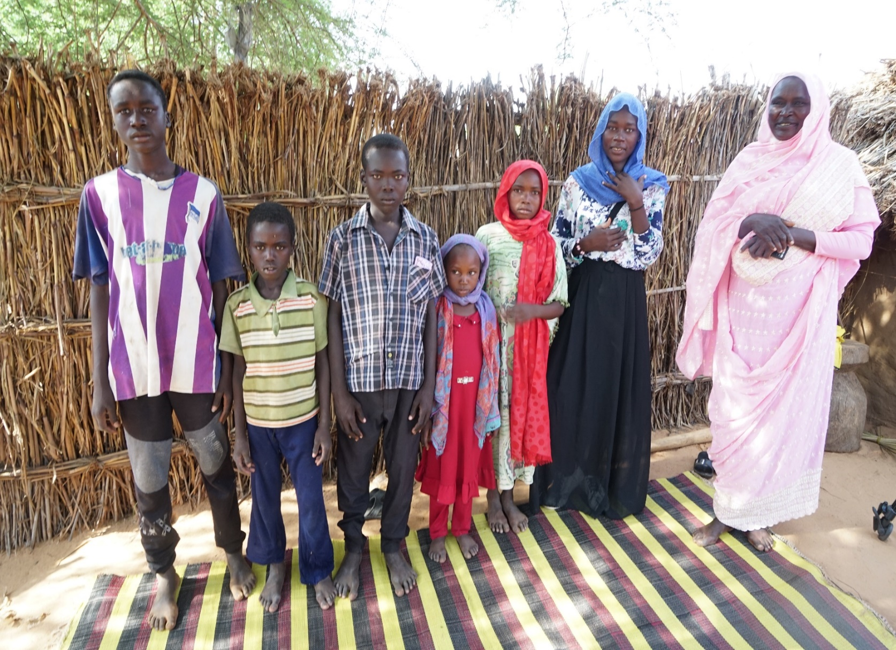
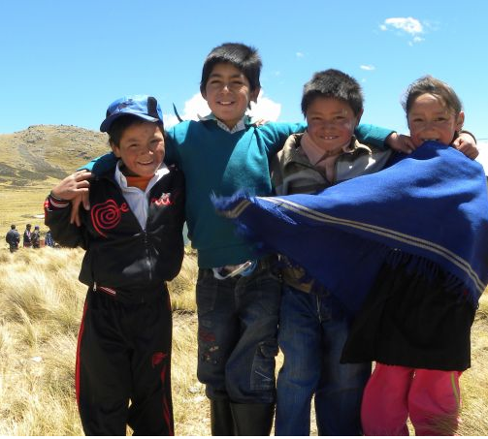
Farming in Sudan
Khadija and her family live in Northeast Sudan.
The area has been badly affected by climate change. Deforestation, drought and flash floods are destroying their homes and making it difficult for them to grow crops.
4
Notes:
This introduces the personal story that the challenge is based on.
Check pupils understanding of deforestation. Maybe ask them how they think deforestation, drought and /or flooding could destroy homes and make growing crops difficult.

Slide 5
Starter
Activity

Slide 6
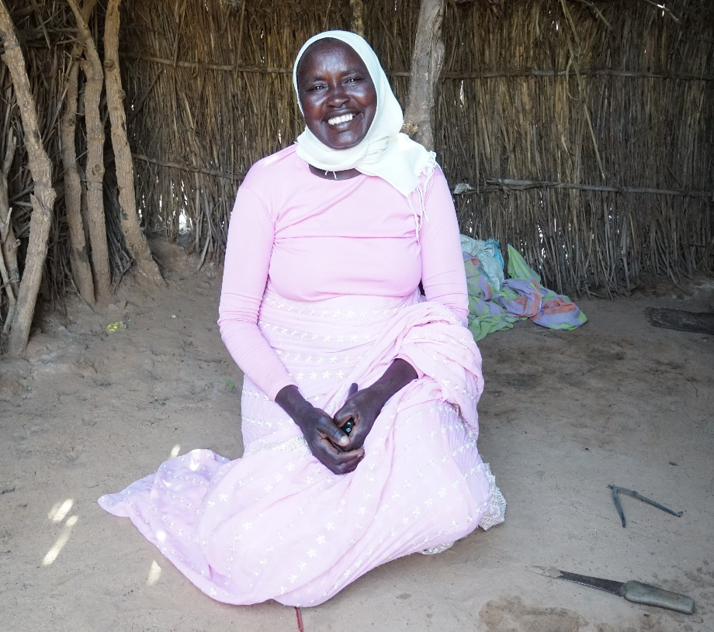
Khadija
Read Khadija’s story about her life as a family farmer in North Darfur, Sudan.
Activity
Working in pairs or small groups read the statements on the True or False cards.
Then decide whether you think the information is true or false. Make a pile of true and false statements.
6
Notes:
Hand out the pupil activity sheet Khadija’s story and allow time for pupils to read then discuss what they have learnt about Sudan and Khadija’s life.
Did anything surprise them? Hand out the True or False cards to find out what they have remembered. Answers are on the next slide.

Slide 7
The capital city of Sudan is Khartoum.
True
The word ‘irrigation’ means watering land to grow crops.
True
If you have enough food to eat you will be healthy.
False
Malnutrition means a person getting fatter or thinner.
False
Drought and flooding cause problems for farmers in Sudan.
True
Farmers in Sudan are lucky because they can grow peanuts.
False
Some crops grow better than others in dry soil.
True
Farmers in Sudan grow plenty of food to sell at the market.
False
Khadija and her family have three meals a day.
False
The official languages of Sudan are Arabic and French.
False
Notes:
True
True
False – As well as enough food you need a variety of different food including plenty of fruit and vegetables to be healthy.
False - malnutrition is when people do not have enough food to eat or a wide enough variety of food to keep them healthy.
True – both drought and flooding are caused by climate change
False - farmers grow peanuts because they can grow in dry soil. Farmers would like to have more water to grow a wider variety of crops such as fruit and vegetables.
True - sorghum, sesame and peanuts can all be grown in drier areas.
False - farmers want to be able to sell food at the market but often can not even grow enough for their own families.
False - they have just one.
False – Arabic and English are the official languages of sudan

Slide 8
Sustainable Development Goals

Slide 9

Sustainable Development Goals (SDGs)
Many people around the world face the same or similar problems as Khadija, trapping them in poverty.
In 2015 the United Nations (UN) called a meeting with leaders from over 30 countries
to work out how best to work together to solve some of the world’s biggest problems.
They identified 17 goals to end poverty in the world by 2030.
They called them:
The Sustainable Development Goals,
also called the Global Goals.
9

Slide 10
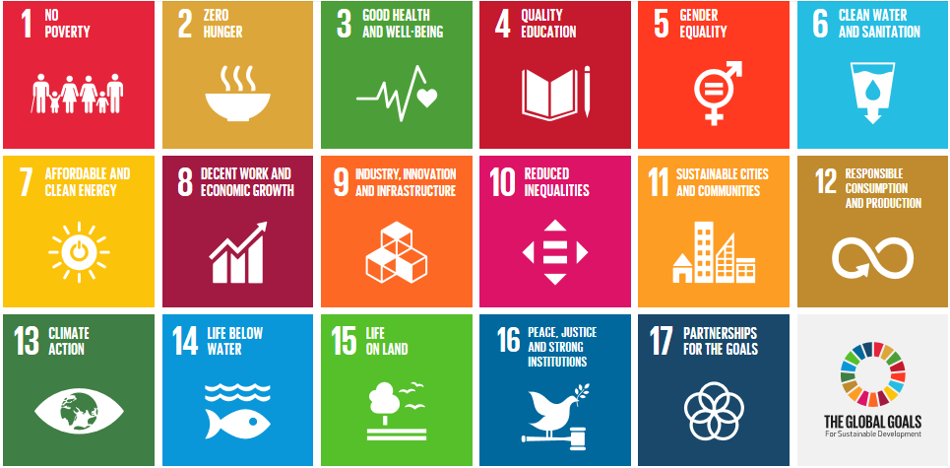
The Sustainable Development Goals (SDGs)
Notes:
This is the full set of Sustainable Development Goals . You may wish to print out for display.
Hand out the Sustainable Development Goals sheet and ask pupils to tick any they think relate to problems Khadija and her children face e.g.
Global Goal 1 - Farmers like Khadija’s who cannot grow enough food to eat or to sell to buy other life essentials are living in
Global Goal 2 - Families like Khadi and her community who are only able to have one meal a day are often hungry
Global Goal 3 - Not having enough food to eat makes it difficult to be healthy ( Global Goal 3)
Global Goal 4 - Often girls have to walk up to four hours a day collecting water, reducing the amount of time they can spend at school.
Global Goal 8 - With Khadija spending so much time collecting water, she has little time to spend on doing work that could earn an income.
There are lots in interconnections. To explore further you could do the Global Goals string activity and who’s responsible – practicalaction.org/global-goals

Slide 11
Under
pressure
Notes:
Hand out the Under pressure pupil activity sheets and materials

Slide 12

Under pressure
In this activity you will find out about water pressure to help you with the main STEM challenge.
Top tips
Make the holes in your bottle the same size.
Have plenty of cloths to wipe up!!
12
Notes:
Go through the under pressure worksheet with pupils.

Slide 13
Regreen the Desert
Notes:
Introduce the challenge.
Explain that STEM skills can be used to solve some of the world’ toughest challenges, and help us achieve the SDGs. They will be looking at just one way that using their STEM skills could help Khadija and her family.

Slide 14

A few ground rules
.
Imagine you are a group of engineers, scientists and designers working together to help Khadija water her crops.
Your model must be able to collect and store rain water.
Water is precious so you need to be able to turn the flow of water on and off.
We want your model to be able to water at least 6 plants at the same time.
At least one of the plants your model waters should be 30cm or more away from where the water is stored.
Design, make and test
a model of a system
that can transport tomatoes in a way that won't squash them!
Can you use your STEM skills to design a model of a system that can collect and store rain water then transport it to at least 6 plants?
Other than that, anything goes! Do your research to help you make the best design. Good luck!
14
Notes:
The challenge is focusing on one of the solutions that can help farmers like Khadija, i.e. irrigating crops.
Pupils are asked to design a model of a system to collect rainwater and dispense it to water crops. You may like to set a homework task or extension activity for older pupils to research more about irrigation systems before the challenge.
Pupils should use the knowledge they gained by carrying out the activities on the Under Pressure worksheet, and also think about how rainwater could be captured.
You could ask GCSE students to calculate the pressure at each hole in Pascals. This extension activity is explained in the teacher’s guide.

Slide 15
At the end of your challenge you will have 3 minutes to present or ‘pitch’ your work on the Regreen the desert challenge.
Remember to leave time to work out how you are going to do this.

Slide 16
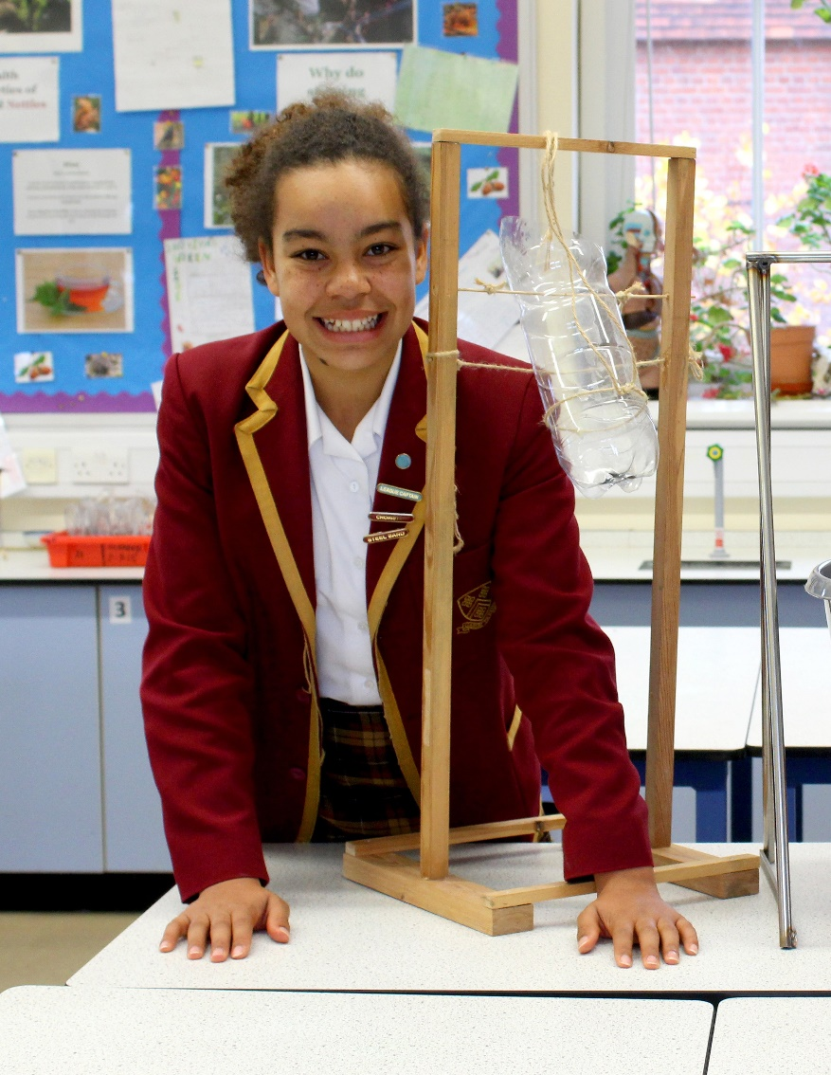
Feedback
Team work
How well did you work together?
Research
What did you find out?
Developing ideas
What ideas did you try out and how did you change your design as a result?
Final design
How successful was it?
How would you improve it if you had more time?
16
Notes:
We suggest that pupils present their model to the rest of the class reflecting on how well they worked together, problems they solved etc. (this will be necessary if you are planning for your pupils to gain a CREST award).
Allow time for pupils to work on their presentations as well as building their model.

Slide 17
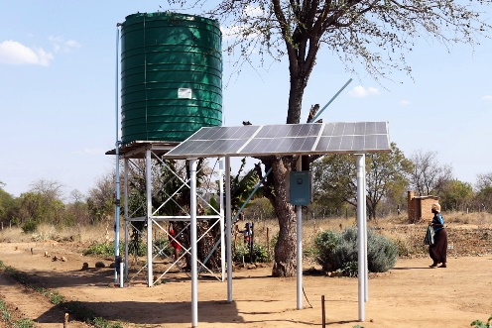
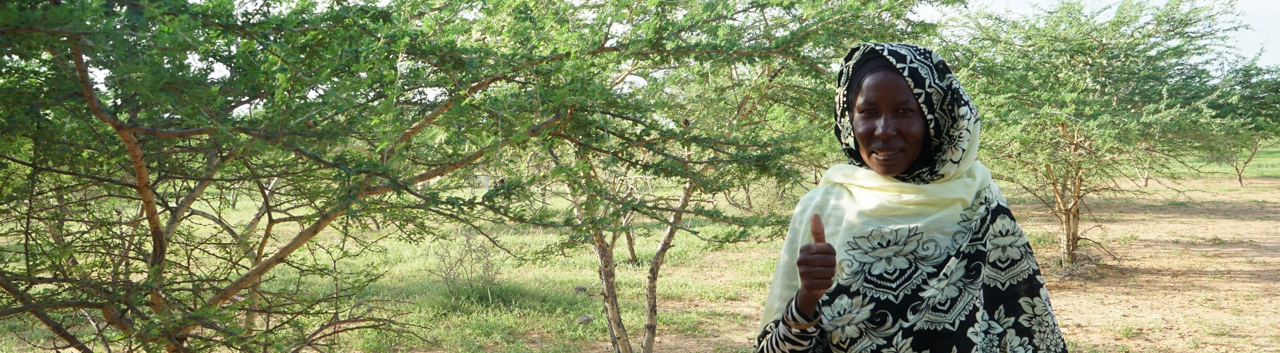
Regreening the desert
In 2020 Practical Action will start working with Khadija and her community on a number of solutions to help overcome climate change. This will enable them to grow more crops, and a wider variety of crops to feed their families and sell to others.
Similar projects have been happening in Sudan for over 25 years. As a result,
thousands of families are now able to succeed and not just survive.
17
Notes:
Pupils may be interested to know that a project led by Practical Action will begin to work with Khadija and her village starting in 2020. The project is called ‘Turning the Tables on Climate Change’ More information about this is available on Practical Action’s website www.practicalaction.org/turn-the-tables

Slide 18
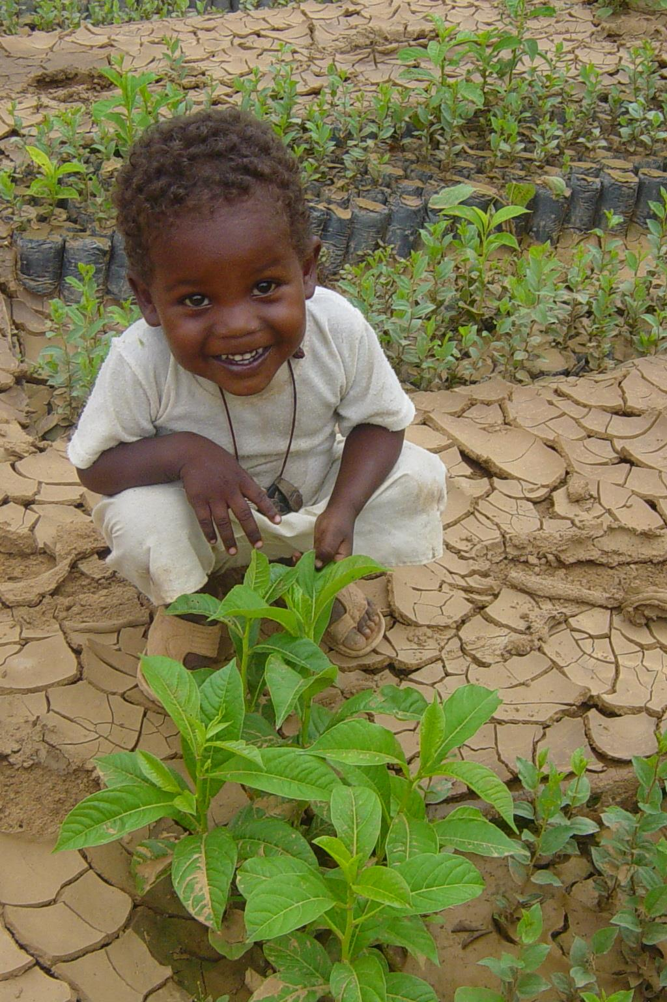
Solutions have included
Capturing water - collecting water that falls in flash floods, e.g. in dams, reservoirs and large containers.
Irrigation - connecting the stored water to where it is needed to water crops.
Replanting - planning forests to regreen the land that had previously been turned into desert (reversing desertification).
Providing seeds - so farmers can grow a wider variety of crops needed to stay healthy.
Training - giving farmers knowledge of better farming methods to improve their productivity.
Notes:
A reminder of the solutions included in Khadija’s story to highlight that irrigation is just one of a suite of many solutions that work together.

Slide 19
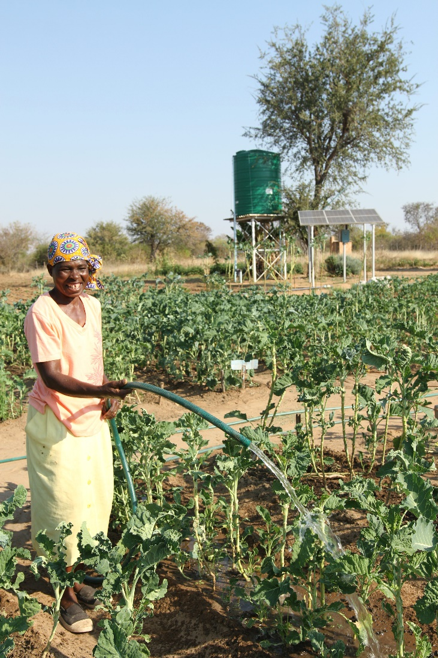
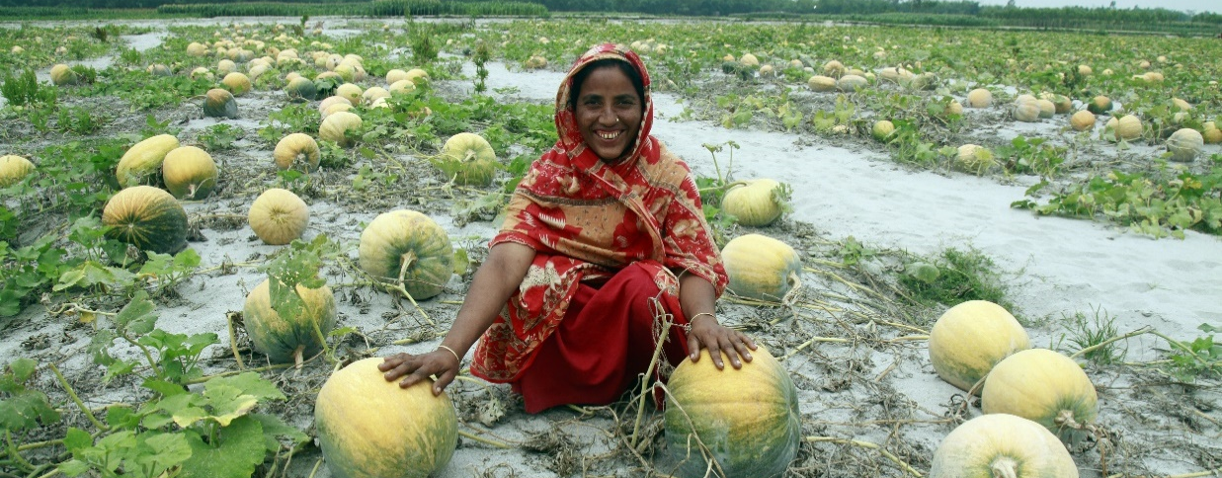
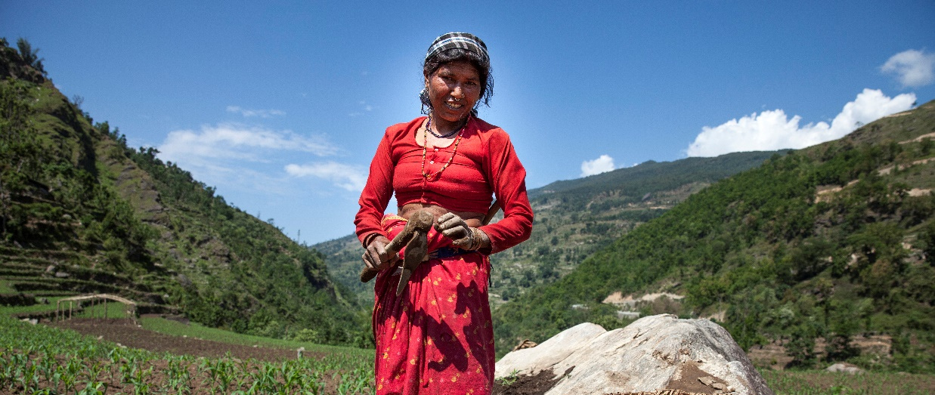
Zimbabwe
Bangladesh
Sudan
Nepal
Notes:
Similar solutions have been used all over the world, including
Zimbabwe ( picture shows a solar powered irrigation pump)
Bangladesh ( picture shows growing pumpkins in infertile land along the riverbank)
Nepal (picture shows irrigation systems high in the mountains)

Slide 20
Celebrating
Success

Slide 21


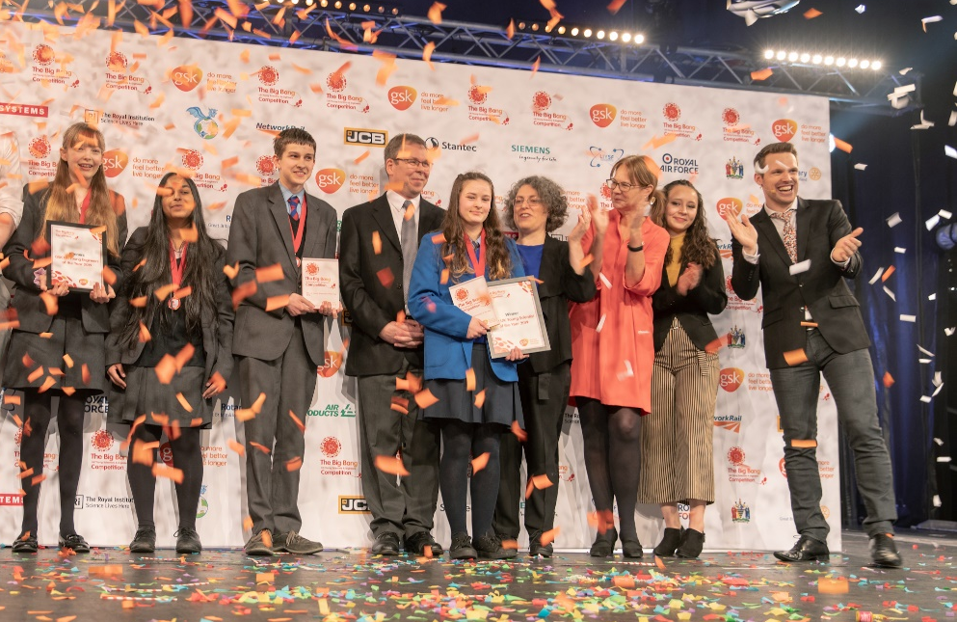
CREST Awards
Regreen the desert is perfect for a CREST Discovery Award. It can also be used to gain a Superstar Award (primary) and as a context for Bronze - Gold Award (secondary)
Big Bang Competition
You can enter your project into the Big Bang Competition, at regional events or online.
200 projects are chosen every year to attend the Big Bang in Birmingham. Prizes include industrial/scientific visits, mentoring, cash and the chance to represent the UK in international competitions.
This could be you next year!
21
Notes:
CREST
Taking part in Regreen the desert is a great way for pupils to gain a CREST Award. The challenge is aligned to the Discovery Award, but can be used to gain a Superstar award or as the starting point for a Bronze, Silver or Gold Award. More details in the teacher’s notes. crest.org
Big Bang Fair and competition
Pupils who have taken part in a STEM challenge can enter their work into the Big Bang competition. This is a great way of pupils showcasing their work to other pupils and adults at a regional Big Bang events.
If they become finalists they will be invited to attend the National Big Bang Fair which takes place in March each year. Both of these are amazing, inspiring experiences for young people.
competition.thebigbangfair.co.uk

Slide 22


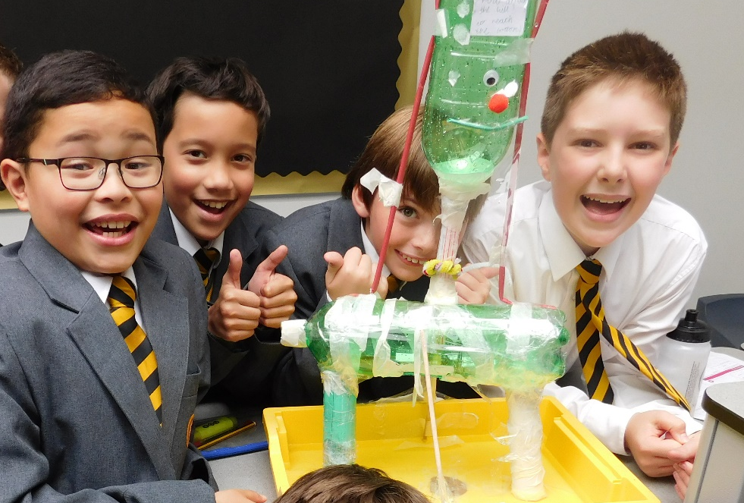
British Science Week
Now you have completed the Regreen the desert challenge why not try some of Practical Action’s other STEM challenges on a special week in March each year? How about the Squashed tomato challenge, Floating garden challenge, Stop the spread, the Solar challenge or Ditch the dirt?
Great Science Share for Schools
A great opportunity for you to share your science projects with other schools, all on one special day in June each year.
22
Notes:
Two great opportunities to join in national initiatives.
British Science Week from the British Science Association. Grants are available https://www.britishscienceweek.org
The Great Science Share for schools had lots of support materials on their main website https://www.greatscienceshare.org/
N.B. Grants are available for British Science Week https://www.britishscienceweek.org/about-us/grants/.

Slide 23











We hope you enjoyed the
Regreen the desert
STEM challenge
For more information and resources go to:
practicalaction.org/schools

