Slide 1
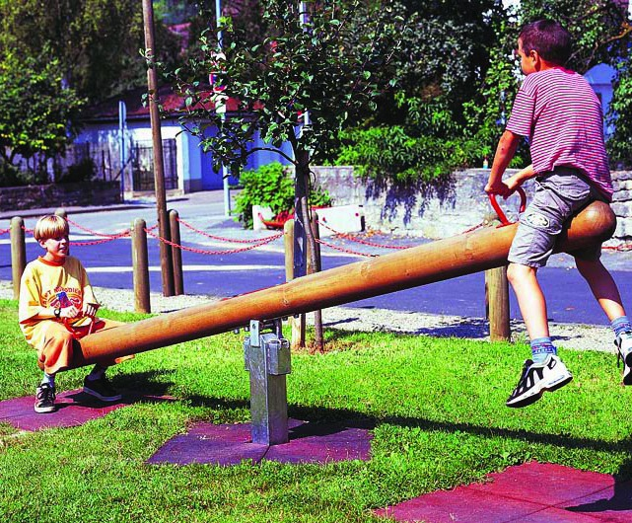
Levers

Slide 2
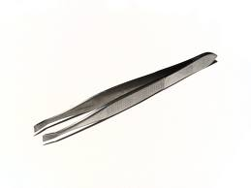
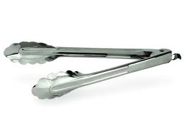
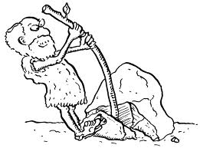
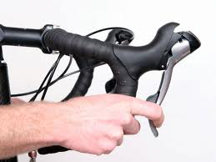
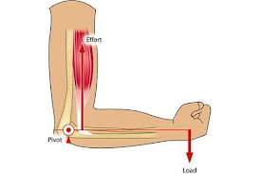
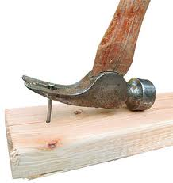
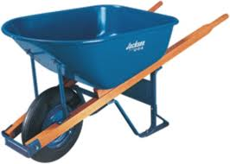
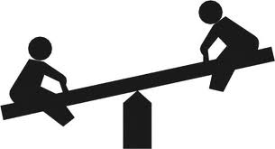
Levers are everywhere!

Slide 3
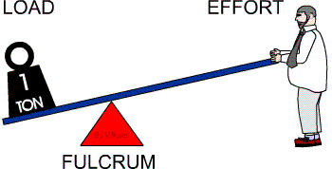
So what are they?
A lever is one of the oldest and simplest machines used by humans. A lever consists of just two parts – a beam (the long part) and a fulcrum or pivot (hinge). The beam rotates (turns) along the fulcrum. Levers are useful because they allow humans to lift heavy weights by applying a smaller force.

Slide 4
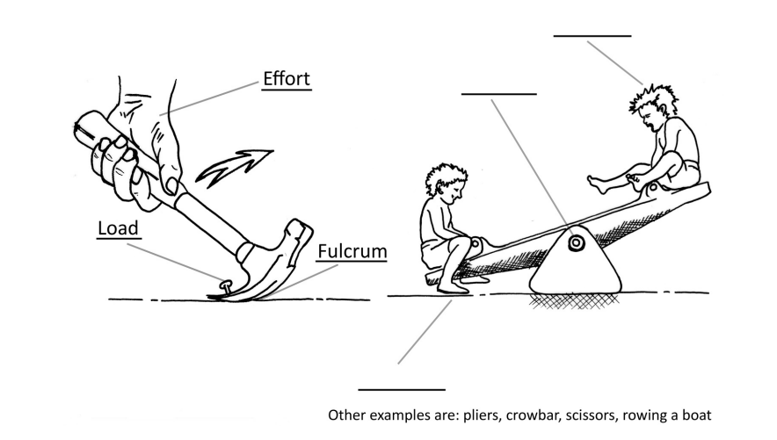
Types of lever Can you label the load, effort and fulcrum?

Slide 5
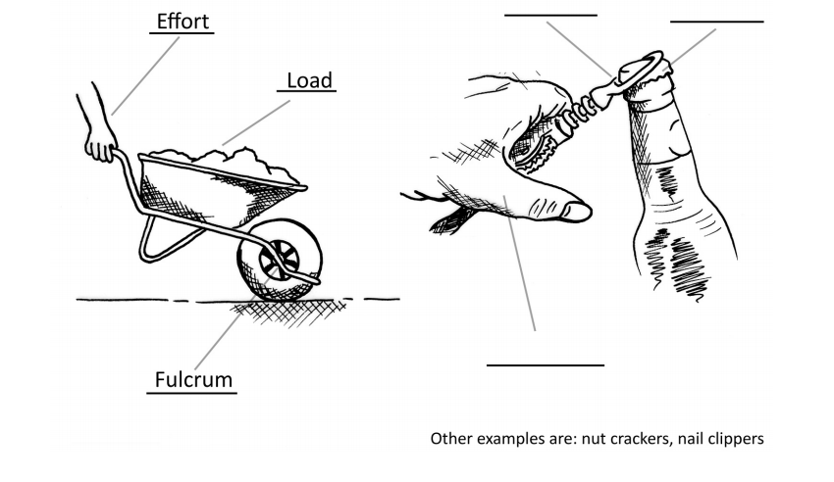
Types of lever Can you label the load, effort and fulcrum?

Slide 6
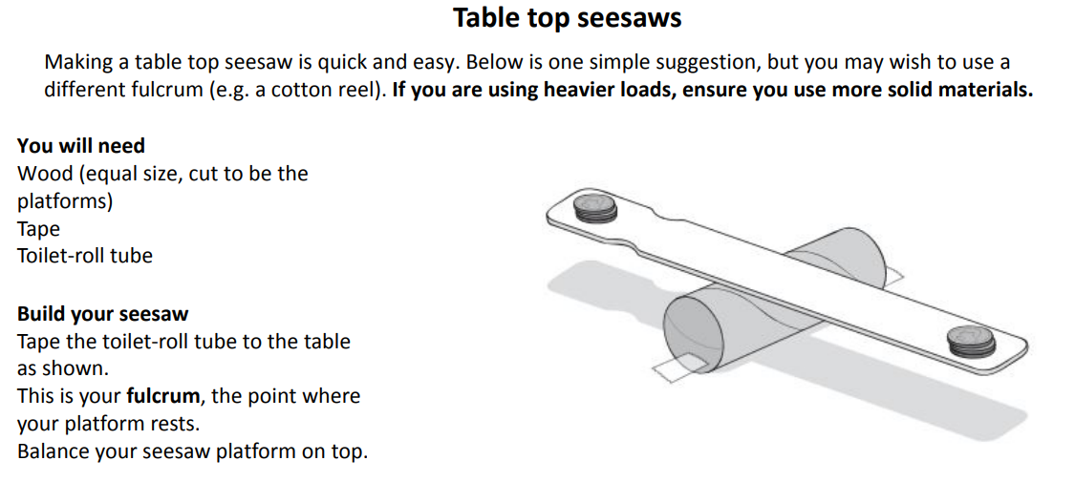
Balance your seesaw using coins or Lego figures (you may need to stick some blutac or something to them to make them heavier). How did you do it?
Now move one pile of coins / Lego character closer to the middle of the seesaw – what happens? Can you explain your observations in terms of forces at work? Are the forces balanced or unbalanced?
See if you can balance your seesaw again – this time by moving the balancing platform (the fulcrum) and not the Lego character – can you explain what is happening?

Slide 7
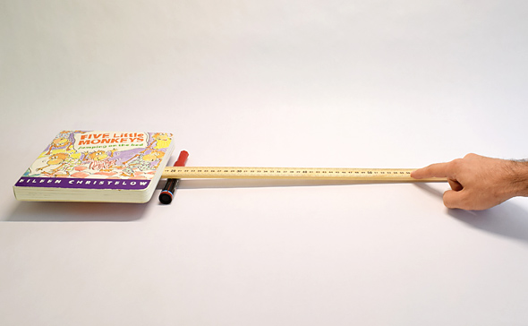
Can you use what you have learned about levers to lift a book with just one finger?
How could you improve your test to lift a heavier book? Think about the variables you could change:
Length of beam
Height of fulcrum
Position of fulcrum
Anything else?
To design a fair test, make sure you change one variable at a time, keeping all the others the same.
Record your data in a table. Below is an example:
Length of beam (cm) | Weight of book lifted (g/kg)

Slide 8
Want to know more? Watch this video from the BBC:
https://www.bbc.co.uk/bitesize/clips/zrp6n39
Challenge: how many levers can you find in your house? What are they used for?

