Slide 1
Adverbials
What are adverbials?
What do we mean when we say an adverbial is fronted?
How do we punctuate adverbials?

Slide 2
Adverbials
Adverbials tell us more about a verb or clause.
Adverbials can be
The lion roared
a word,
a phrase,
or a clause.
desperately
in the distance
as he arrived

Slide 3
Adverbials answer the questions…
Jabu heard the lion.
Jabu heard the lion in the distance.
Jabu heard the lion as he sat and thought.
Jabu heard the lion with surprise.
Where?
When?
How?

Slide 4
Adverbials
Adverbials often have a preposition at their head.
The cage held the lion with its steel bars.
The cage held the lion in its grip.
The cage held the lion as it roared and raged.
The preposition links the adverbial to the rest of the sentence.

Slide 5
Fronted Adverbials
Adverbials can be placed at the beginning or end of a clause.
When an adverbial appears in front of the sentence it is modifying…
it is called a fronted adverbial.
No special punctuation needed
Comma after the fronted adverbial
The lion was calm during the rescue.
Jabu glanced with a nervous expression.
Promises were forgotten before long.
They were safe finally.
During the rescue, the lion was calm.
With a nervous expression, Jabu glanced.
Before long, promises were forgotten.
Finally, they were safe.
Fronted adverbials are separated from the main part of the sentence by a comma.

Slide 6
Spotting and Punctuating Adverbials
ANSWERS
Spot the adverbial in each sentence.
Decide if punctuation is needed and where.
Without warning the lion roared.
The donkey answered them with a bitter laugh.
Like a leaf Jabu shook.
Thinking quickly the jackal closed the cage.
The Lion roared from inside.
,
,
,

Slide 7
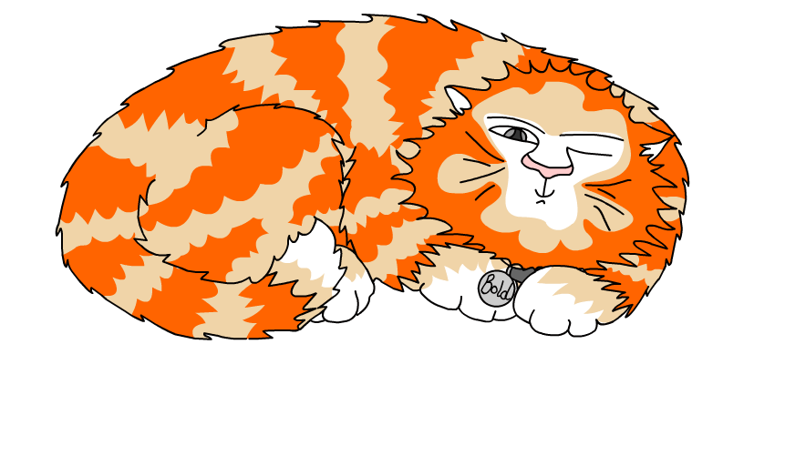
Explore more Hamilton Trust Learning Materials at https://wrht.org.uk/hamilton/ .

