Slide 1
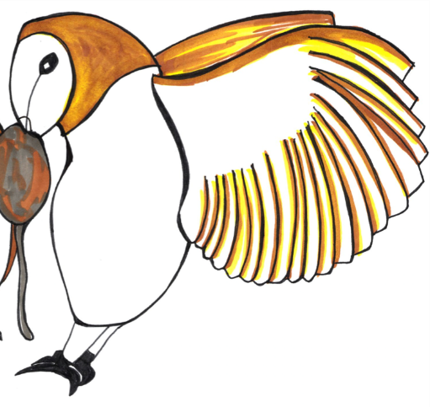
Noun Phrases

Slide 2
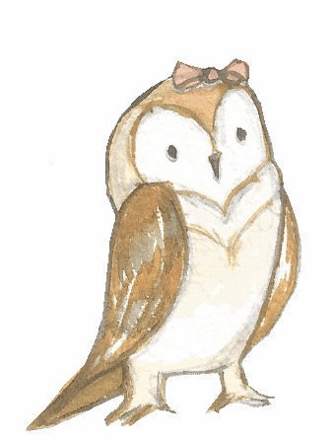
Nouns
A noun names a person, place, idea, thing or feeling.
an owl
the cat
a boat
that surprise
In front of a noun, we often have ….
a an the this that his her their my your

Slide 3
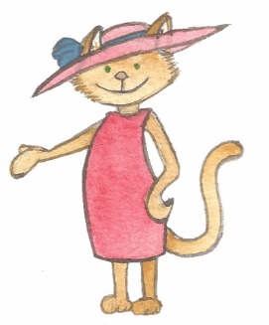
Adjectives
An adjective is a describing word.
It tells you more about a noun.
the elegant owl
an awesome cat
this sturdy boat
that big surprise
The island was spooky.
Adjectives sometimes come next to ‘their’ nouns…
but sometimes they do not.

Slide 4
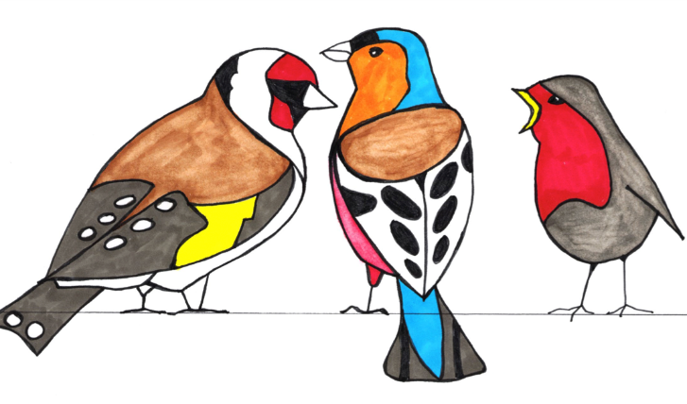
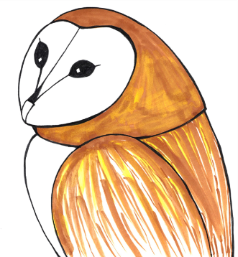
Noun Phrases
A noun phrase adds extra detail to the noun.
the bright, golden bird
a chirpy and cheerful robin
this quite amazing woodpecker
that truly elegant owl
It can be made by adding an adjective or two.

Slide 5
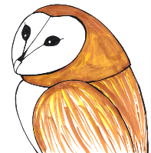
Noun Phrases
A noun phrase adds extra detail to the noun.
The main noun is called the head noun.
a beautiful pea-green boat
a horribly bored man
an exceedingly large nose
a very sharp chin like a pin
a hilarious limerick with funny characters
The head noun is what the phrase is about.
Can you spot the head noun in each of these phrases

Slide 6
Expanding Noun Phrases using Prepositional Phrases

Slide 7
Prepositions
Prepositions tell us how words are related.
above
of
on
with
over
without
outside
between
from
inside
by
Prepositions are useful for adding extra information about a noun.
under
from
below

Slide 8
Expanded Noun Phrases
You can develop an expanded noun phrase by using a prepositional phrase.
The wild, windswept island
The wild, windswept island over the sea
Useful prepositions
with, of
by, from, on, under, beyond, below, between, inside, next to, over, in, outside
The wild, windswept island beyond the horizon
The wild, windswept island with palm trees
The phrase modifies the noun.

Slide 9
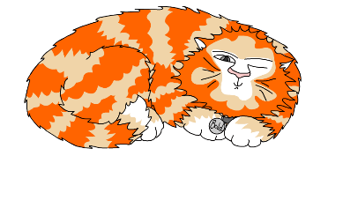
Explore more Hamilton Trust Learning Materials at https://wrht.org.uk/hamilton/ .

