Slide 1


Classify and sort quadrilaterals.
Draw two different quadrilaterals (4 straight sides).
Describe your shapes and agree what is different and what is the same about them.
Does one shape have at least one pair of perpendicular sides?
What shape is it?
Does one shape have at least one pair of parallel sides?
What shape is it?
Does one shape have four equal sides?
What shape is it?
Does one shape have four right angles?
What shape is it?
Rectangles have four right angles.
A rhombus has four equal sides, but two different angle sizes (opposite angles equal).
Squares have four right angles AND four equal sides.

Slide 2
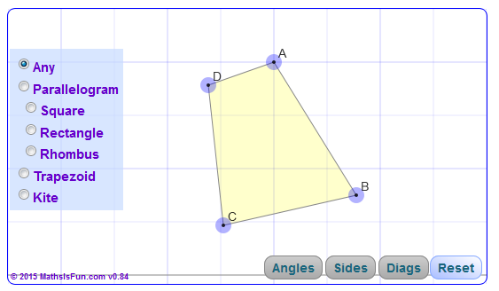
Classify and sort quadrilaterals.
Let’s explore quadrilaterals!
Click on the picture to go to the site.
Click on ‘angles’ and each shape in turn.
Move a vertex (corner)…
What happens to the shape?
Repeat, this time clicking on ‘diagonals’.

Slide 3

Classify and sort quadrilaterals.
What criteria could we use to sort these quadrilaterals in this Venn diagram?
at least 1 pair of parallel sides
at least 1 line of symmetry
4 equal length sides
equal opposite angles
one or two pairs of parallel sides
4 right angles

Slide 4
Classify and sort quadrilaterals.
How have these quadrilaterals been sorted?
Two lines of symmetry
No right angles

