Slide 2

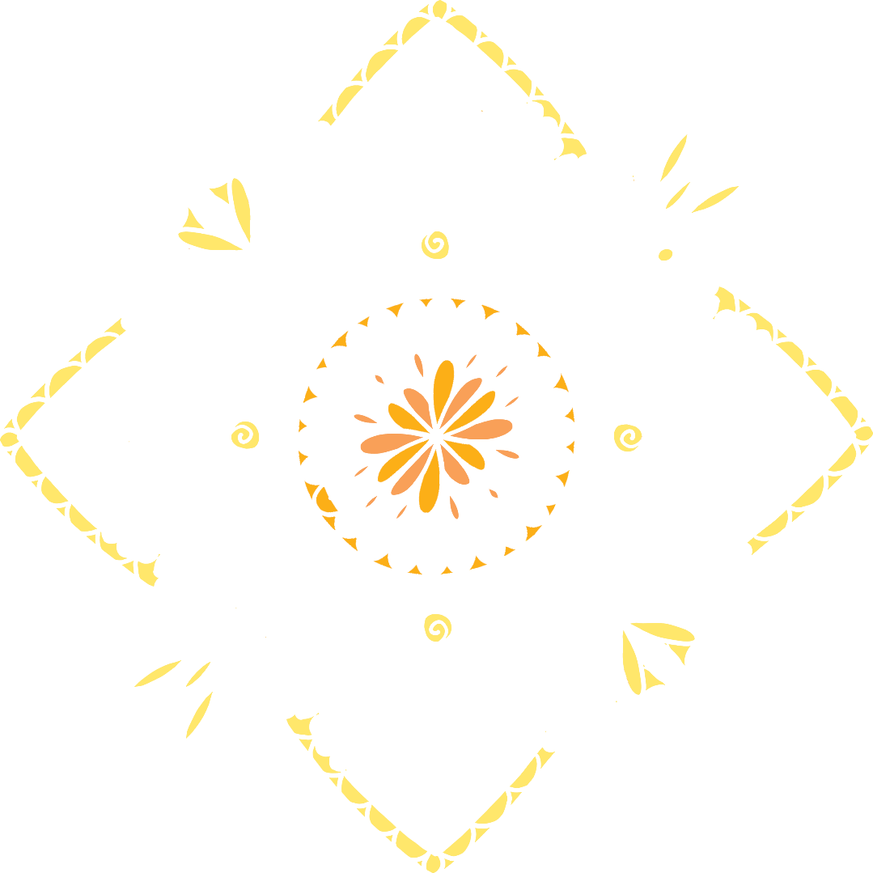


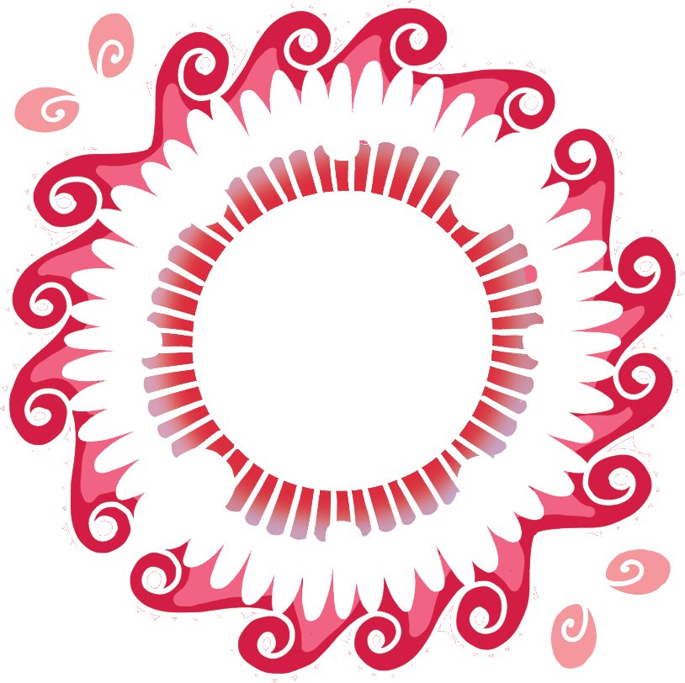

What Is Rangoli?
Rangoli is a type of art
that started in India.
A rangoli design is
made up of beautiful
coloured patterns.
The designs are often
very detailed.

Slide 3
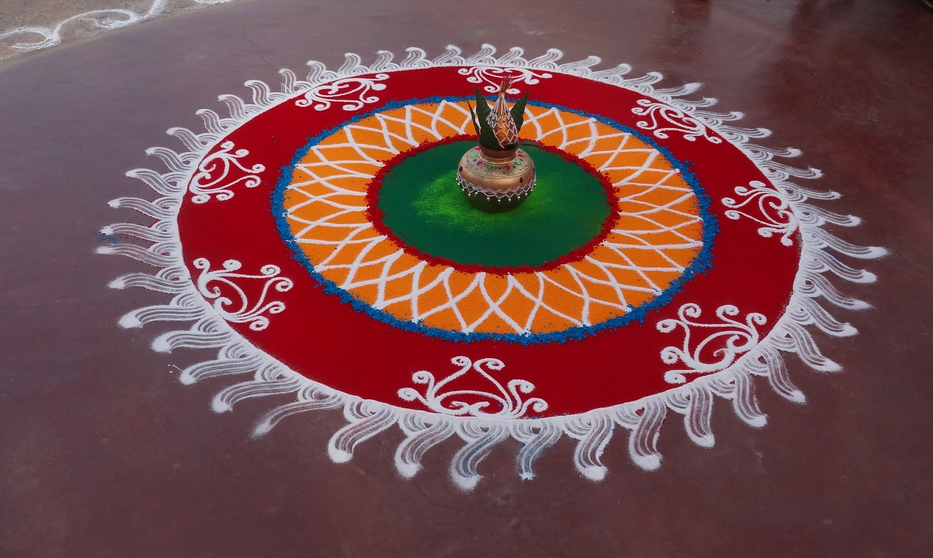
Celebrating with Rangoli
Rangoli designs are usually made during festivals and celebrations.
Lots of rangoli patterns are created during Diwali. They can also be seen at other Hindu festivals and special occasions, such as weddings.

Slide 4
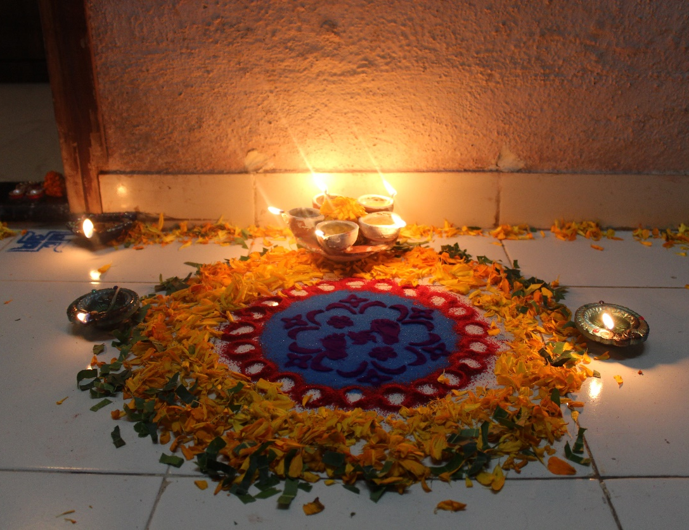
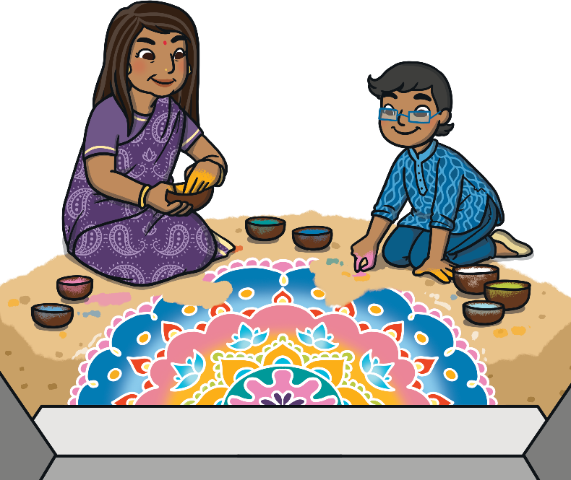
Celebrating with Rangoli
Rangoli designs are thought to bring good luck.
During Diwali, rangoli patterns are created at the entrance to people’s homes to welcome Goddess Lakshmi. Diya lamps are often added.

Slide 5
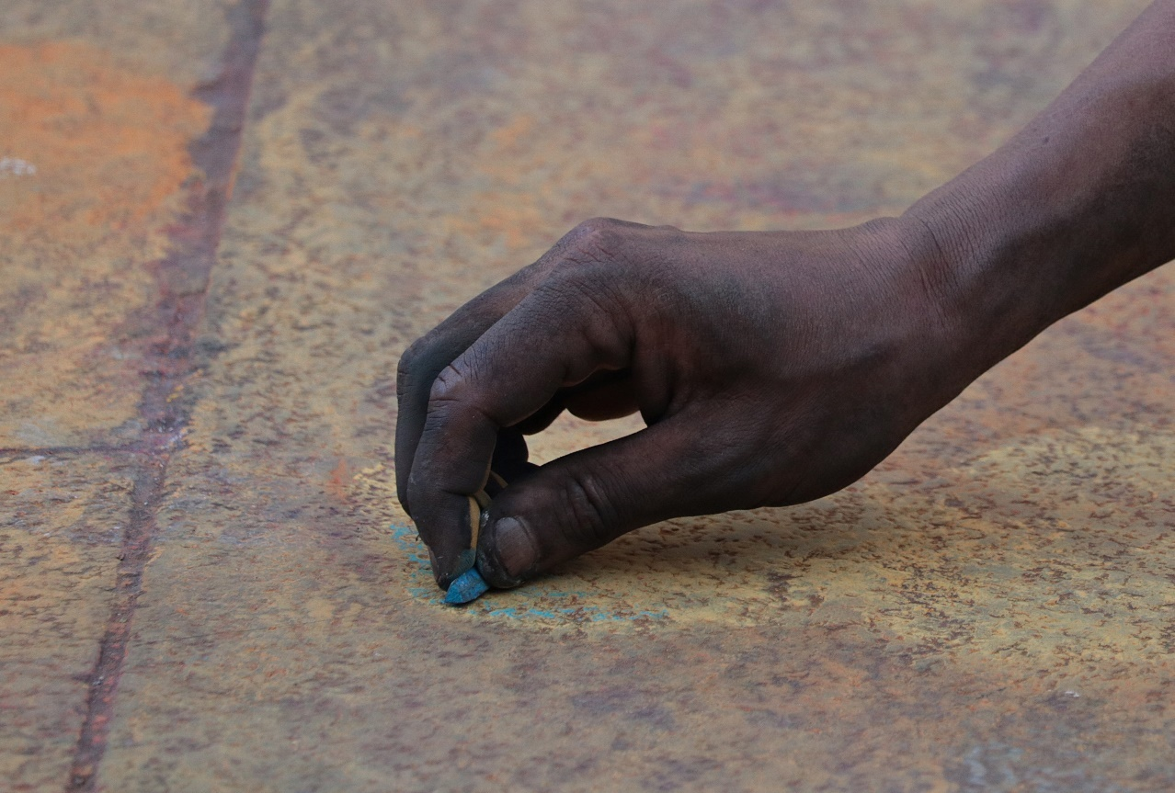
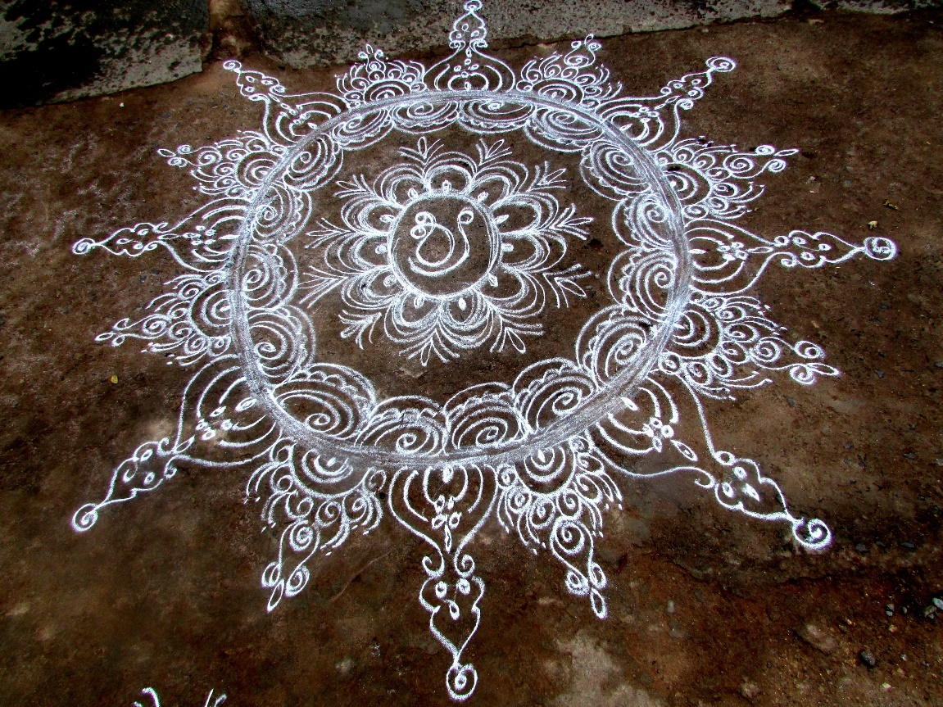
How Are Rangoli Designs Made?
Each rangoli design is different. The designs are passed down from generation to generation. The different designs include different shapes or images.
Rangoli patterns are always made on the floor. The outline is often created before being filled in with colour.

Slide 6
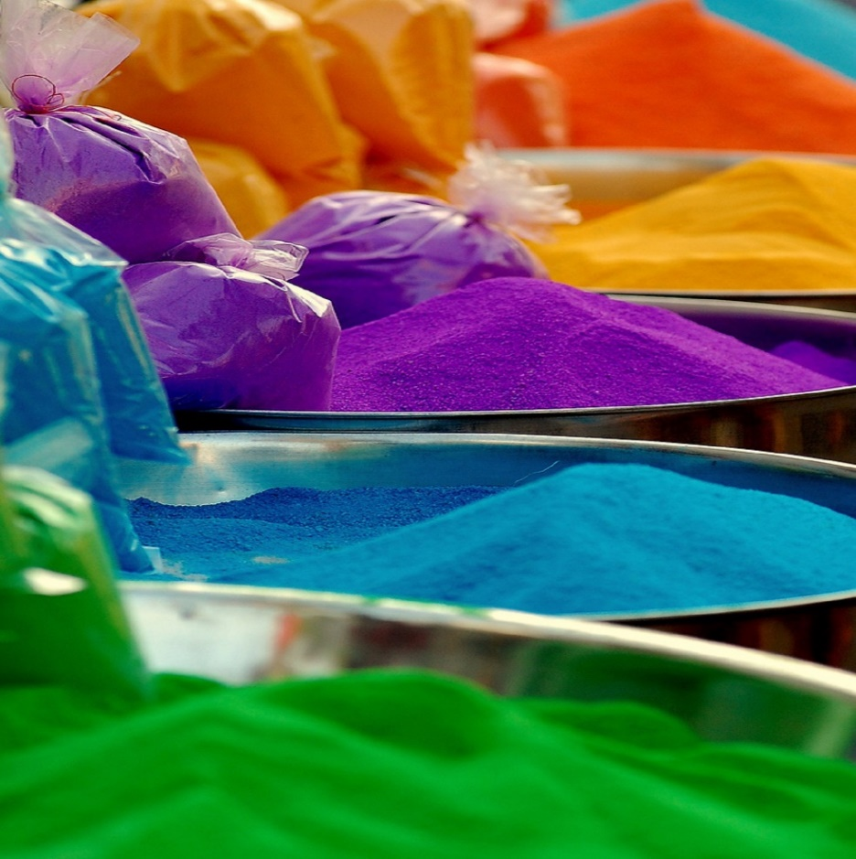
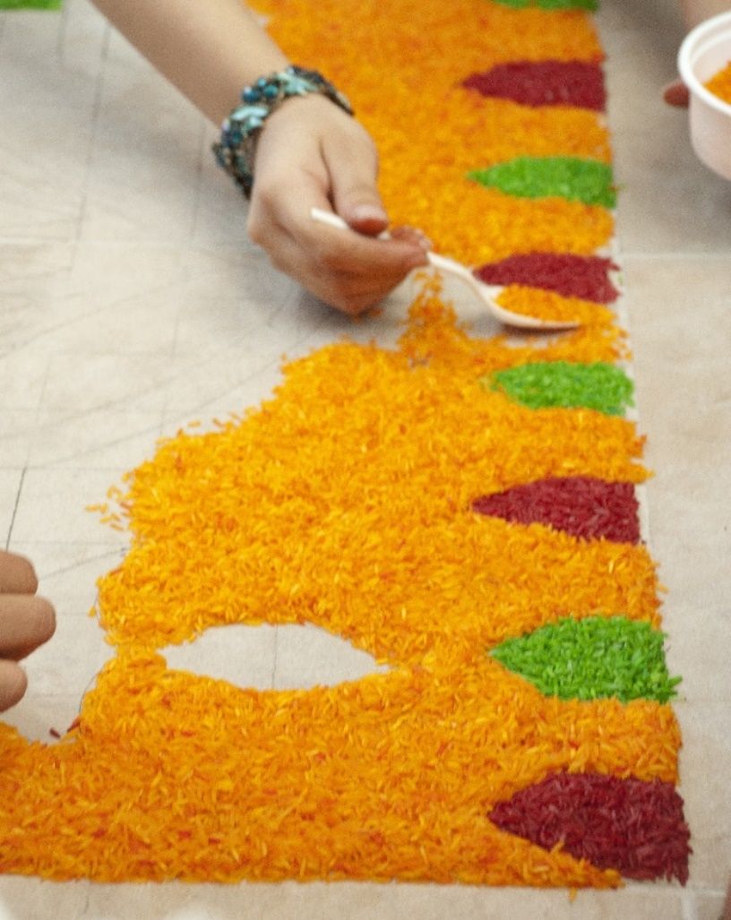
How Are Rangoli Designs Made?
Sometimes, coloured powders are used.
They can be made using different colourful materials. The materials used are things that most people can get easily, without spending lots of money. This means that everyone has the chance to make them.
Coloured rice can also be used in the designs.

Slide 7
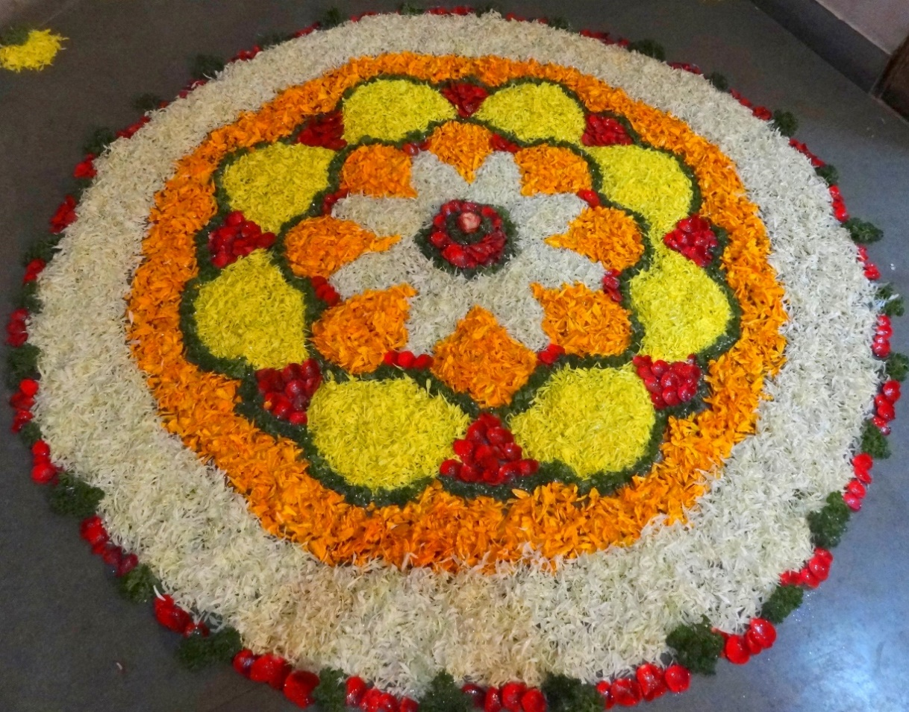
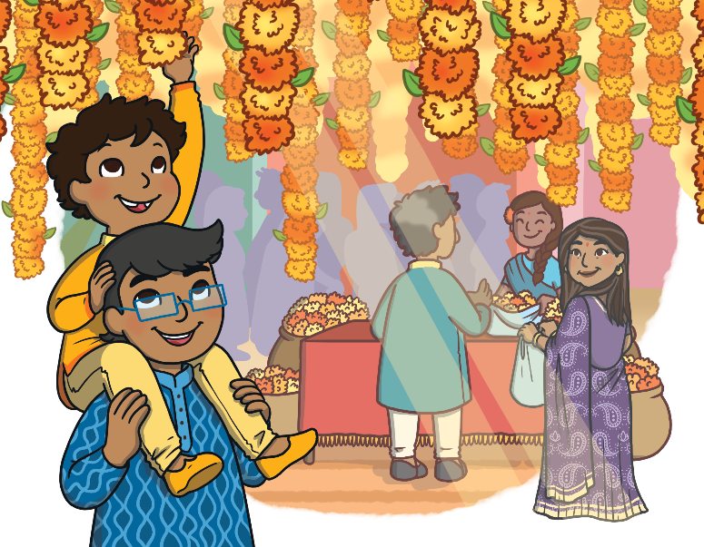
How Are Rangoli Designs Made?
Some rangoli artists use flowers and petals to add the colours.
Marigold flowers are a popular choice.

Slide 8
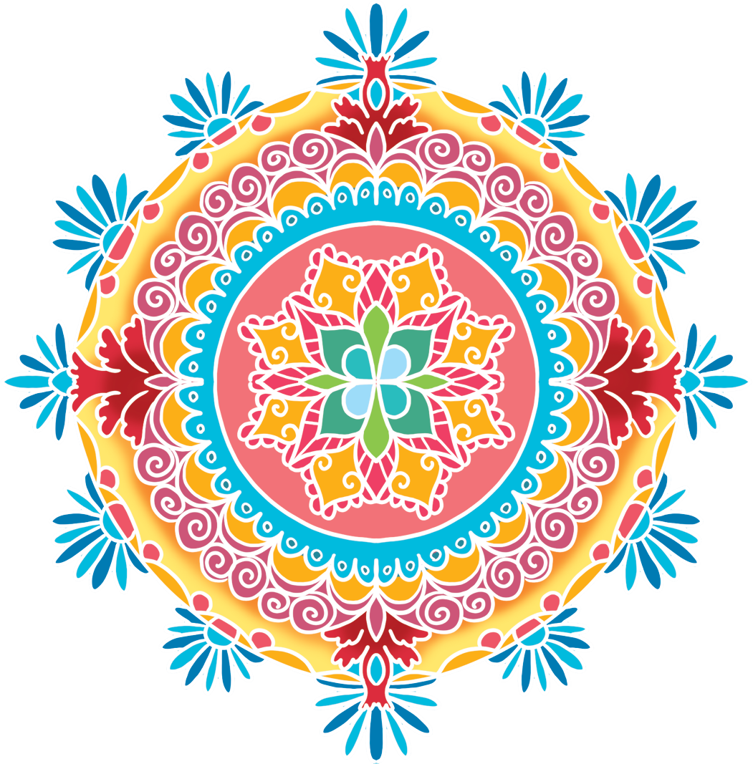
Symmetrical Rangoli
Many rangoli designs are symmetrical. They often
include geometric shapes,
as well as lots of curved
and straight lines.

Slide 9
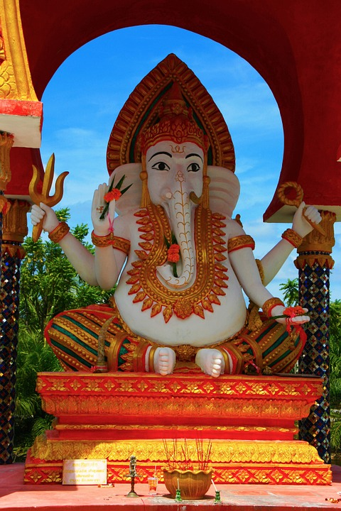
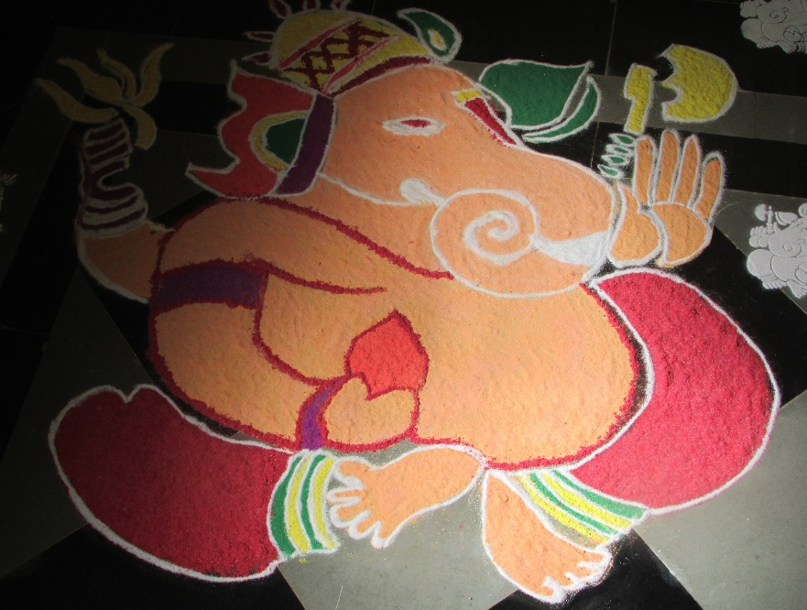
Drawing the Gods
Some rangoli artists include pictures of gods in their designs. This artist has included an image of the Hindu God, Ganesha.
Ganesha is an elephant-headed Hindu god. He is the lord of arts and sciences, as well as the god of beginnings.

Slide 10
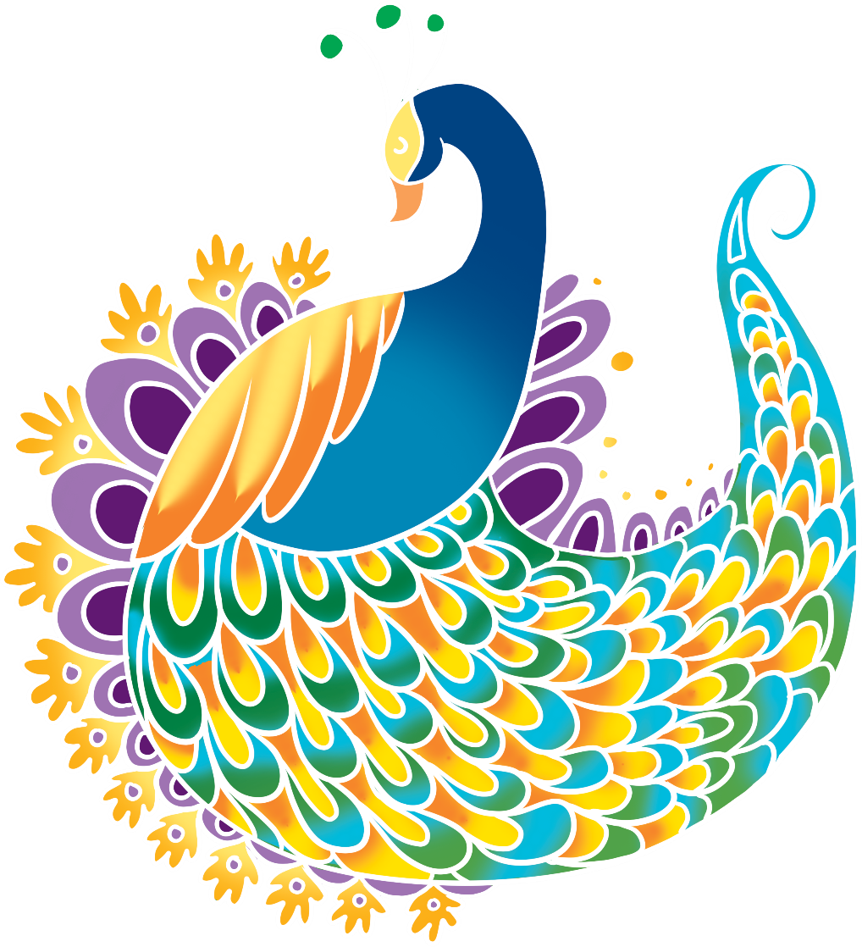
Beautiful Birds
Beautiful birds can often be
seen in rangoli designs, such
as parrots or peacocks.
Artists often choose very
colourful birds because
it is very important that
the rangoli design has
lots of colour.

Slide 11
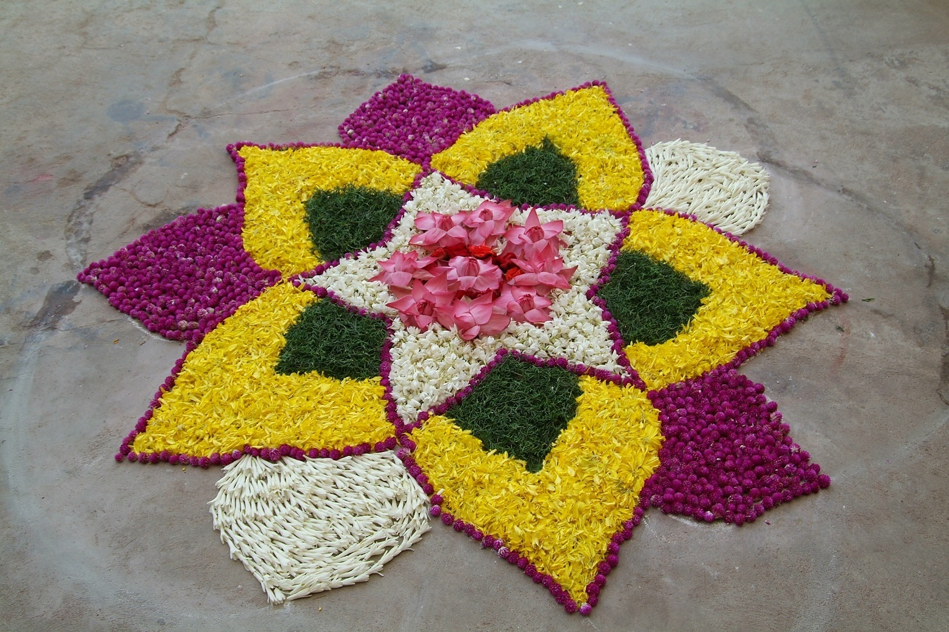
Flower Designs
Rangoli artworks are sometimes made in the shape of flowers.

Slide 12
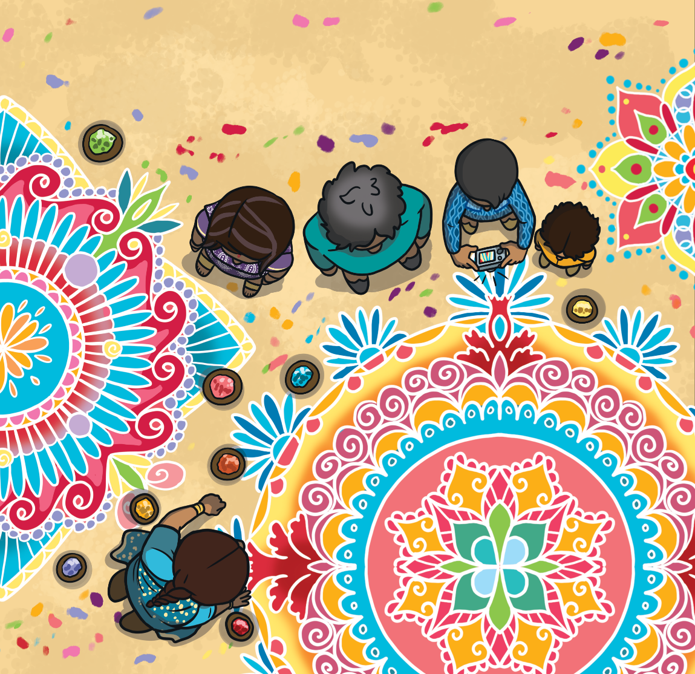
Rangoli Competitions
In some parts of India, towns and villages hold rangoli competitions.
Individuals or teams
make the best rangoli designs they can.
Other people then come
to view and admire the artworks.

