Slide 1

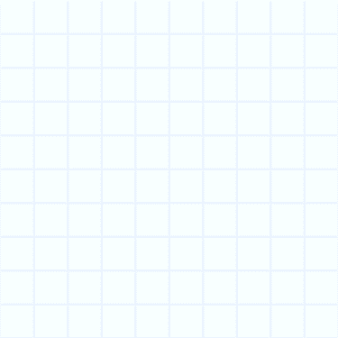

Understand how to read an array. Use beaded lines and grouping to help write division number sentences.
I have 3 packets of 6 buns. Draw an array to show 3 lots of 6 buns.
Let’s check that…
3 × 6 = 18

Slide 2


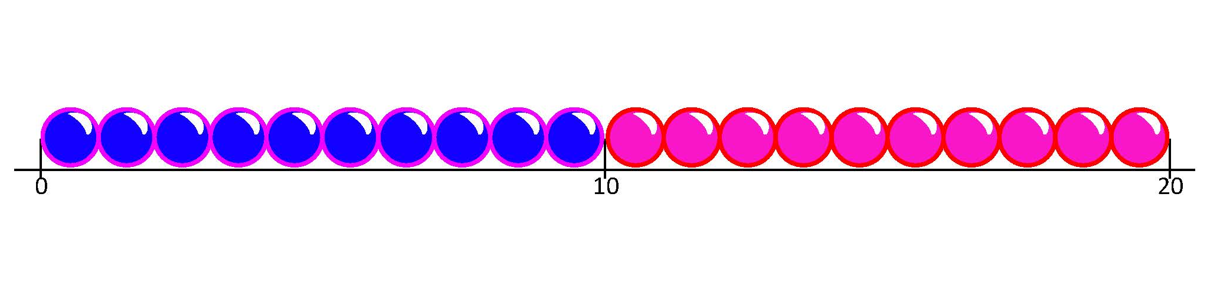
Know that division is the inverse of multiplication. Create and solve division problems.
If there are 18 buns altogether and the baker puts them into packets of 6, how many packets will he need? What are we going to have to do to solve this problem?
How many groups of 6 are there in 18? We can use a beaded line to find out! Let’s draw jumps of 6 and see how many there are until we reach 18.
Now start with the number 18. Can you think of a word problem that starts with 18 buns and involves grouping?
+6
+6
+6
18
There are 3 jumps, so there are three 6s in 18. 18 ÷ 6 = 3.
The baker needs 3 packets.

