Slide 1
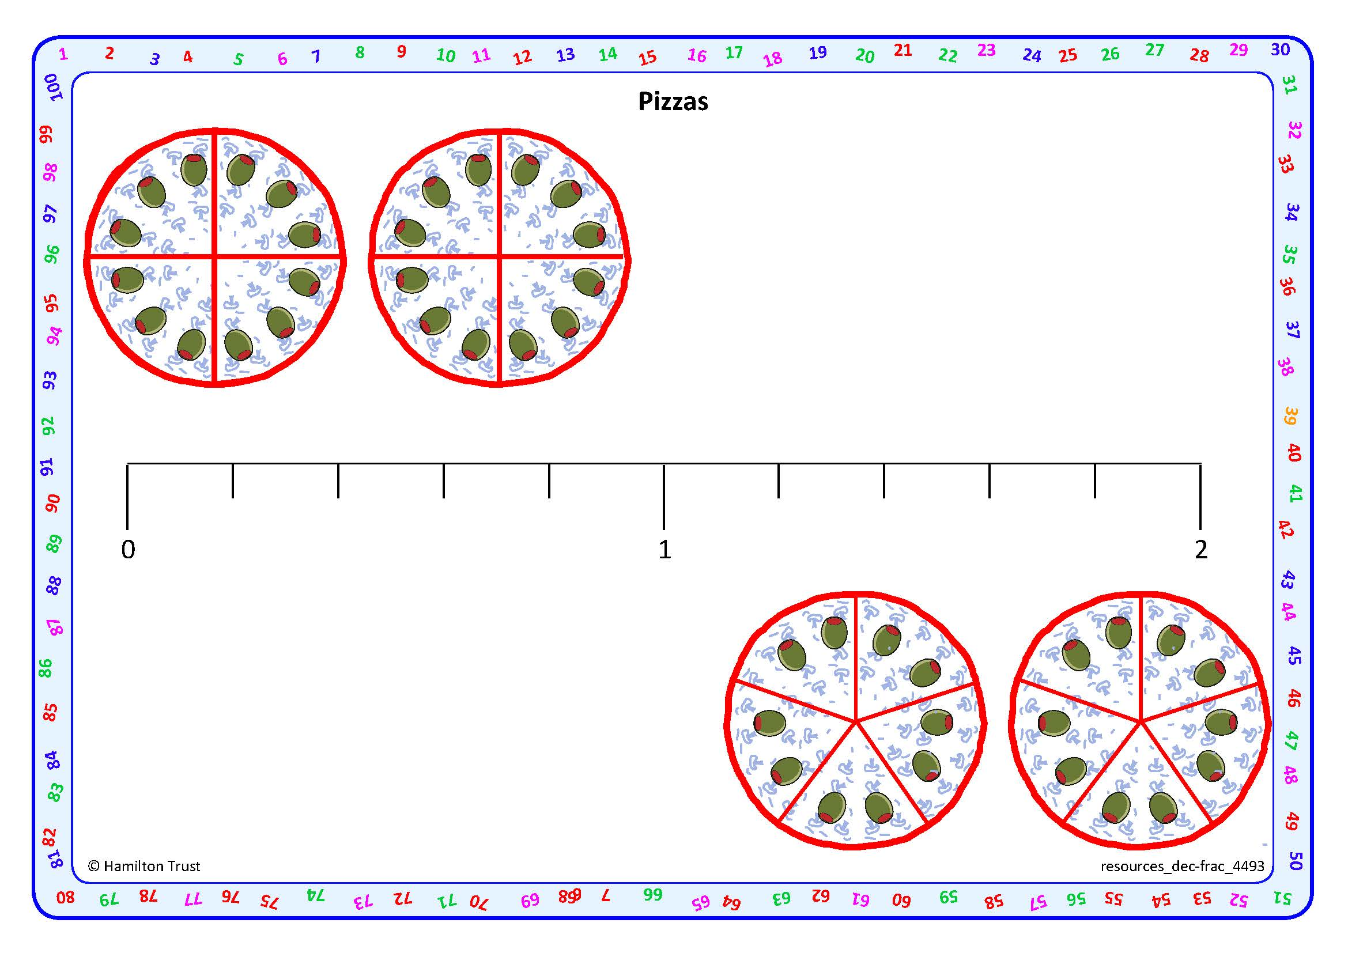


Add and subtract fractions with the same denominator.
These pizzas are divided into ¹/₄s.
First ³/₄ is eaten.
Then another ²/₄.
³/₄ + ²/₄ = ⁵/₄
How many ¹/₄s have been eaten altogether?
How else can we write ⁵/₄ ?
As a mixed number:
1¹/₄

Slide 2
Add and subtract fractions with the same denominator.
These pizzas are divided into ¹/₅s.
First ⁴/₅ are eaten.
Then another ³/₅.
⁴/₅ + ³/₅ = ⁷/₅
How many ¹/₅s have been eaten altogether?
How else can we write ⁷/₅ ?
As a mixed number: 1²/₅

Slide 3
Add and subtract fractions with the same denominator.
We can also show this on a fifths numberline.
⁴/₅
⁷/₅
Mark ⁴/₅
Count on ³/₅
⁴/₅ + ³/₅ = ⁷/₅ or 1²/₅

Slide 4
Add and subtract fractions with the same denominator.
We can also use the numberline to subtract.
Let’s try 1³/₅ - ⁴/₅.
⁴/₅
1³/₅
Mark on 1³/₅
Count back ⁴/₅
1³/₅ - ⁴/₅ = ⁴/₅

Slide 5
Add and subtract fractions with the same denominator.
Let’s try 1¹/₅ - ³/₅.
³/₅
1¹/₅
Mark on 1¹/₅.
Count back ³/₅.
1¹/₅ - ³/₅ = ³/₅

