Slide 1
War Heroes
A VE Day Celebration

Slide 2
World War 2
World War II started on 1st September 1939. The war began because Germany had invaded Poland. Despite warnings from Britain and France, Germany continued and they declared war two days later.
Brave British men and women fought in the army, navy or air force and many lives were lost.
In Britain, people faced many difficulties. These included:
Rationing – people were only allowed to buy a certain amount of particular foods.
Evacuation – children in many cities were sent to live in the countryside, away from their parents.
Bombing – enemy planes often dropped bombs on large cities and ports. People had to avoid shining lights at night and ‘black out’ their windows and hide in air raid shelters during bombing attacks.
Missing loved ones – many men and some women went away to fight and did not return home for many years.

Slide 3
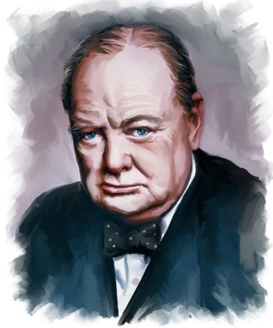
The End of The War
In Europe, the second world war ended on 8th May 1945. Great Britain had been fighting for nearly six years!
This is commemorated every year and is called VE Day, which stands for Victory in Europe.
The Prime Minister, Winston Churchill, announced on the radio at 3pm that Germany had surrendered.
The country celebrated and there were many street parties across Great Britain.
There was still fighting in Japan, and World War II didn’t finally end until 2nd September 1945.

Slide 4
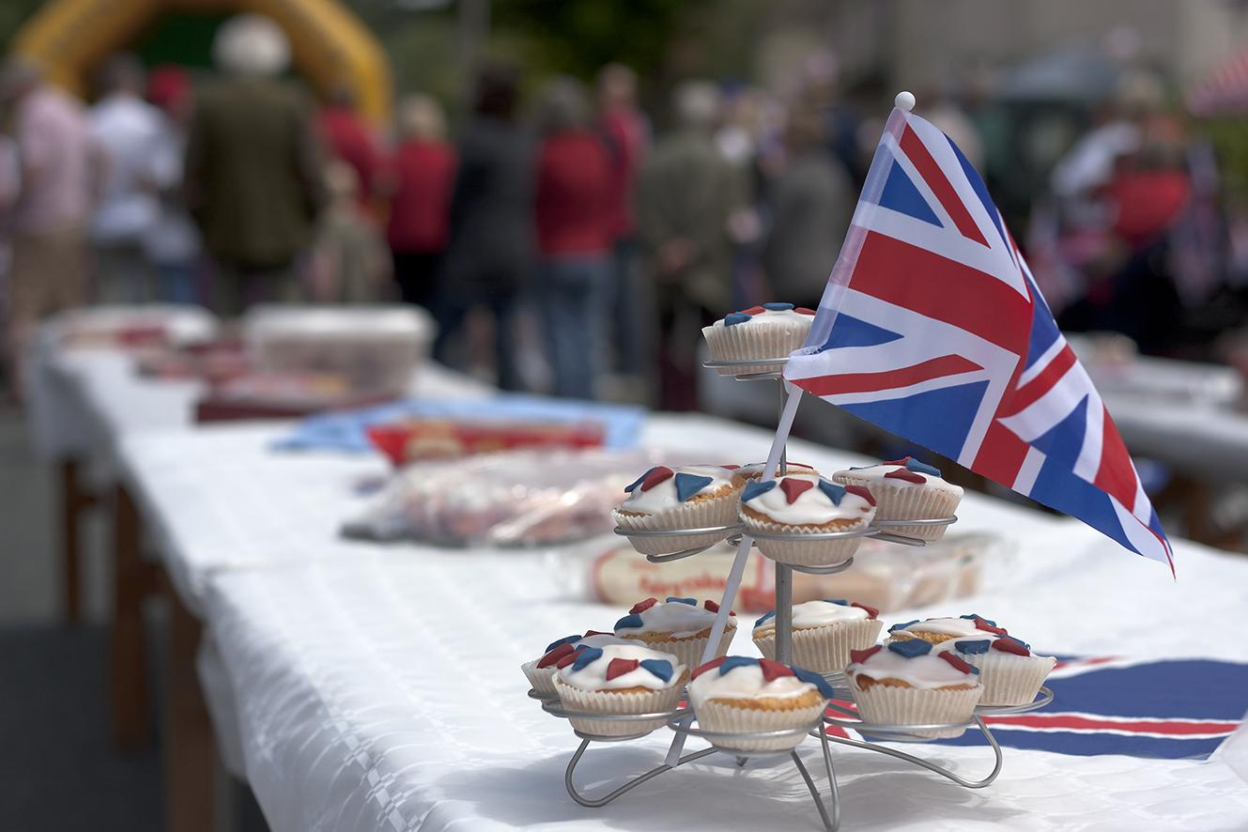
75th Anniversary!
This year will be the 75th anniversary of VE Day. Many events had been planned across the country to celebrate peace and also remember those who died; but now we need to find ways to mark the occasion at home.

Slide 5
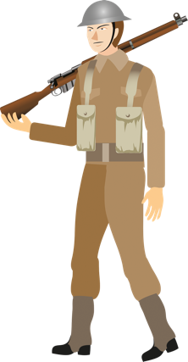

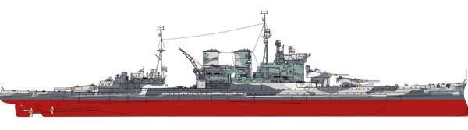
Remembering
On VE Day, people will remember the service men and women who fought during the second world war and the sacrifices that they made.
army
air force
navy

Slide 6
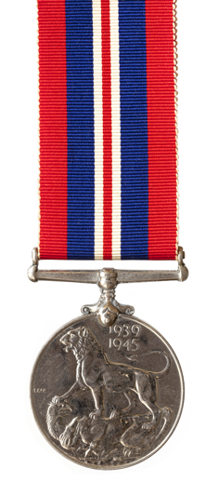
Returning Home
When the service men and women from the army, navy and air force returned home, they were given medals to show how grateful the nation were that they had fought for the country.
Why do you think the nation (Great Britain) was grateful?

Slide 7
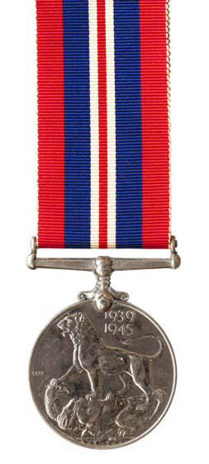
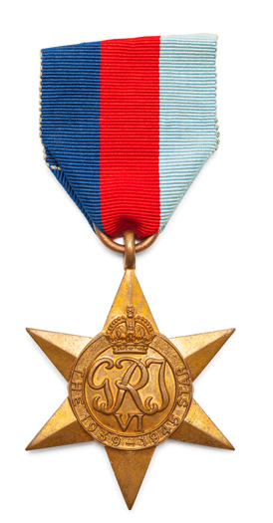
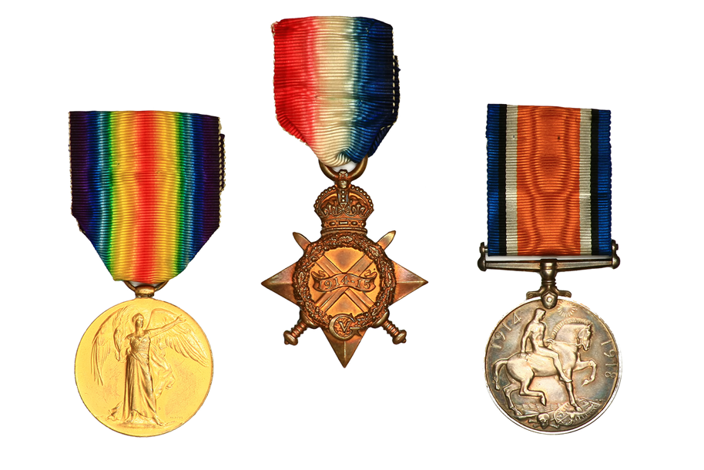
War Medals
War medals contained many symbols.
What symbols
can you see on these medals?
World War II medals
World War I medals

Slide 8
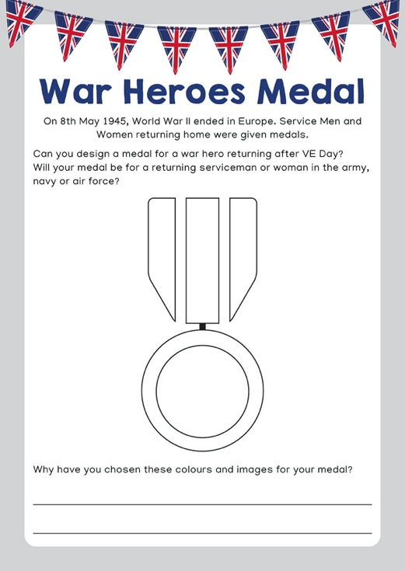
Design a War Heroes Medal
Design a medal for a member of the army, navy or air force returning home after VE Day.
Think about which symbols and colours you might include.

Slide 9
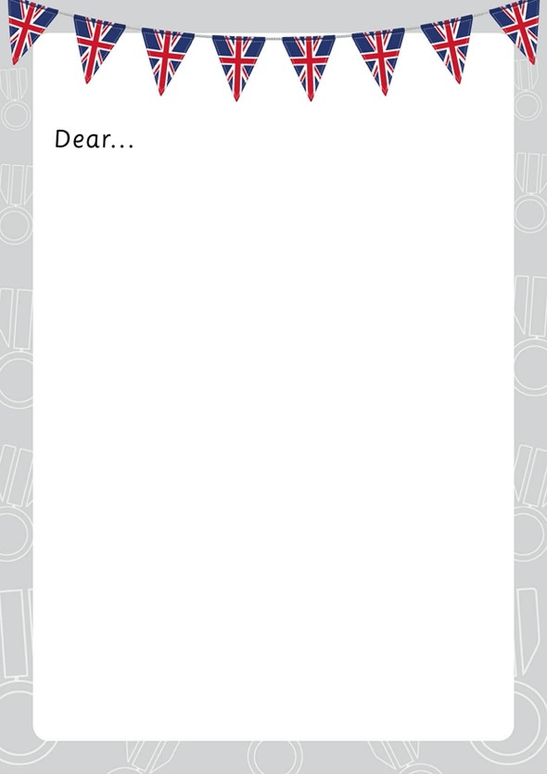
Writing Task:
Write a letter to a service man or woman, telling them why they are receiving the medal.
Try and use some of these words in your letter:
brave bravery courage grateful sacrifice celebrate VE Day war

