Slide 1
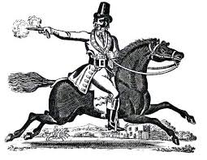

Perfect Verb Forms
The Highwayman
The highwayman had ridden through the wood.

Slide 2
Perfect form
The perfect form marks relationships of time and cause.
PAST
NOW
Passage of time
Perfect (completed) action…
He galloped away.
affects the present
simple past tense
This happened in the past at a time before now.
Past perfect form is used in The Highwayman. It describes events that were completed in the past at the time of the poem’s narrative.
present perfect -
completed in the past. He is now away.
Perfect (completed) action…
affects the past
He has galloped away.
He had galloped away.
past perfect -
continued up to a time in the past.
It affected the past.

Slide 3
Present Perfect Form
The present perfect form suggests that
a past action is still affecting the present.
still affecting the present.
Bess met the highwayman in the past and she still knows him.
Simple past | Present Perfect form
Bess met the highwayman.
Bess has met the highwayman.
He wore his hat in the past and it is still on his head!
He wore his hat.
He has worn his hat.
Tim listened.
Tim has listened.
Tim listened in the past and he still heard them.

Slide 4
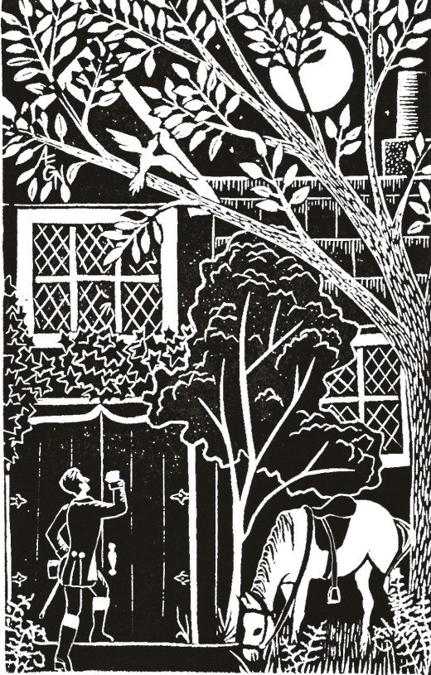
Past Perfect Form
The past perfect form suggests that an action had an effect on another point in the past.
The highwayman had ridden across the moor.
He had tapped his whip on the shutters.
He had whistled a tune at the window.
Bess had waited for him.
She had plaited her hair into a love-knot.
They had met in secret.
The verbs were completed (perfected) in the past.
The result has an effect on a past point (the moment of the poem).
Past perfect form gives clues to time and cause.

Slide 5
Answers
Past Perfect Form
The perfect form is created by using the auxiliary verb ‘have/has’
and the past participle of a verb.
They had tied her up to attention.
The landlord's black-eyed daughter had watched for her love in the moonlight.
They had tied her up to attention.
The landlord's black-eyed daughter had watched for her love in the moonlight.
They tied her up to attention.
They have tied her up to attention.
Can you spot the past perfect form of the verbs?
How would the timing change if it was in simple past or present perfect form?
Notes:
‘They tied her’ suggests this happened in the past and is now over. ‘They have tied her’ suggests that the tying happened in the past and that Bess is still tied up now!

Slide 6
Present Perfect and Past Perfect Forms
The perfect form is created by using the auxiliary verb ‘have/has’
and the past participle of a verb.
The auxiliary verb indicates whether the verb form is past or present.
I brushed my hair (simple past).
I had brushed my hair (past perfect).
I have brushed my hair (present perfect).
For past perfect: use had.
She ate the pizza (simple past).
She had eaten the pizza (past perfect).
She has eaten the pizza (present perfect).
For present perfect:
have is used for I, you, we and they,
has is used for third person (he, she).

