Slide 1

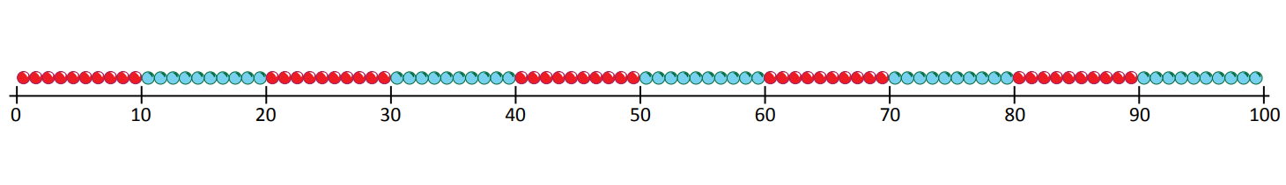

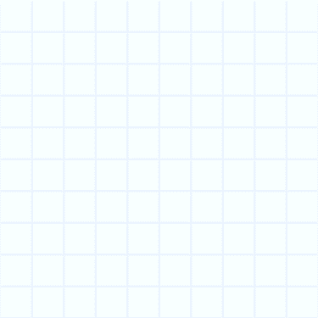
Round 2-digit numbers to nearest multiple of 10.
32
Where would 32 go on this line?
Is it nearer to 30 or 40?
To round 32 to the nearest 10, we round it ‘down’ to 30 because that’s the closest multiple of 10.

Slide 2
Round 2-digit numbers to nearest multiple of 10.
68
Where would 68 go on this line?
Is it nearer to 60 or 70?
To round 68 to the nearest 10, we round it ‘up’ to 70 because that’s the closest multiple of 10.
Why bother learning to round?
If we were adding the prices of lots of toys, and just needed to know roughly how much the whole lot would be, we could round each price to the nearest £10 and then add them.

Slide 3

Round 2-digit numbers to nearest multiple of 10.
45
Where would 45 go on this line?
What is 45 rounded to the nearest 10?
So, 45 is in the middle of 40 and 50.
We need a rule for rounding numbers that sit half-way between
multiples of 10.
We always round up.
45 rounded to the nearest 10 is 50.
65 rounded to the nearest 10 is …
95 rounded to the nearest 10 is …
15 rounded to the nearest 10 is …
25 rounded to the nearest 10 is …
30
20
100
70

