Slide 1

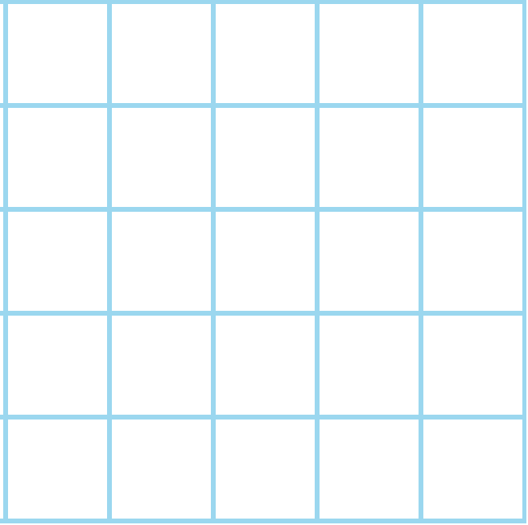

Find the area of triangles.
How might we find the area of the blue triangle, drawn here on squared paper?
We could count whole squares and pair up partial squares to make whole squares.
What is the area of this rectangle?
So what is the triangle’s area?
But we can also use the fact that this triangle has half the area of a 4 by 2 rectangle.
The area is 8 square units

Slide 2
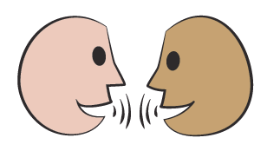
Find the area of triangles.
As before, we can use the fact that this triangle has half the area of a rectangle.
It measures 4 by 8 squares.
Talk to someone about how to find the area of this triangle.
4
8
So, what is the triangle’s area?
The area is 16 square units

Slide 3
Find the area of triangles.
This triangle doesn’t have a right angle, but the perpendicular height (h) splits it into two right-angled triangles.
And we can draw a rectangle round each of the two smaller triangles to help find the area of each triangle; then add them together.
h
b
Now we’ve done this, do you see that the whole blue triangle has half the area of the whole rectangle that encloses it?!
The ‘formula’ to find the area of a triangle can be written as follows:
Area = ¹/₂ of the base times height
= ¹/₂ x b x h
= ¹/₂bh

Slide 4
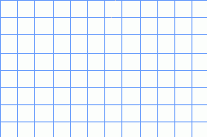
Find the area of parallelograms.
Talk to someone about how we could find the area of this parallelogram.
How might it be split into shapes whose area we do know how to find…
6 square units
36 square units
6 square units
Now we can find the area of each triangle and the square in the middle.
36 + 6 + 6…
The area is 48 square units

