Slide 1

1) Noun
2) Verb
3) Adjective
4) Adverb
5) Preposition
6) Determiner
7) Pronoun
8) Conjunction
Word Classes
Which terms do you remember?

Slide 2
Nouns
A noun names a person, place, idea, thing or feeling.
a poem
the sea
a myth
an image
More on determiners in a moment!
In front of a noun, we often have
a an the
Determiners

Slide 3
Verbs
Verbs indicate that someone or something is
doing, feeling or being.
We paddled.
The sea roared.
The boat was old.
Something attacked us.
We lost hope!
Usually verbs have the name of a person or thing or a pronoun in front of them.

Slide 4
Adjectives
An adjective is a describing word.
It tells you more about a noun.
those strange noises
that mysterious smell
a cold, creepy feeling
its green claws
The claws were green.
Adjectives sometimes come next to ‘their’ nouns…
but sometimes they do not.

Slide 5
Adverbs
Adverbs often modify verbs.
They can also modify adjectives,
or a whole clause.
The creature rose then.
We fought hard against it.
Its claws slashed furiously.
It had horribly sharp claws.
We were very frightened.
It was too strong for us!
Suddenly, it froze.
Then, it sank beneath the waves.
Perhaps, we were safe.

Slide 6
Prepositions
Prepositions link a noun or noun phrase to a sentence.
We continued our voyage
on the ship.
We repaired our vessel
after the attack.
We kept watch
because of the creature.
beneath the waves.
It could still be lurking
Prepositions tell us how words are related.
They can tell us about time, place and cause.

Slide 7
Determiners
Determiners stand in front of nouns.
They specify a noun.
A shadow loomed on the horizon.
any shadow
The shadow loomed on the horizon.
That shadow loomed on the horizon.
a particular shadow
My shadow loomed on the horizon.
Your shadow loomed on the horizon.
a shadow which belongs to…
Every shadow loomed on the horizon.
Some shadows loomed on the horizon.
a specified number of shadows

Slide 8
Pronouns
Pronouns can stand in the place of a noun or noun phrase.
What pronouns could replace these nouns and noun phrases?
They
it
The sailors steered their ship into a very turbulent storm.
She
them
The brave captain knew that it would be a difficult journey for the crew.
It
hers
it
The responsibility was the captain’s but she wondered about the real cause of the tempest.

Slide 9
Conjunctions
Co-ordinating conjunctions
and
but
or
Co-ordinating conjunctions join two words or clauses.
What conjunctions could be inserted?
The kraken lurked under the water and waited.
It might sink the ship now or it might play with it for a while.
Subordinating conjunctions
when
while
before
because
so
if
unless
although
The kraken was not hungry but it was angry at the intrusion.
Subordinating conjunctions introduce subordinate clauses.
It was nearly midnight before the kraken acted.
What conjunctions could be inserted?
Huge tentacles gripped the ship while the crew slept.
Because the ship began to rock violently, the captain woke up.

Slide 10
1) Noun
2) Verb
3) Adjective
4) Adverb
5) Preposition
6) Determiner
7) Pronoun
8) Conjunction
Word Classes
Which terms do you remember now?
Can you give examples of them?

Slide 11

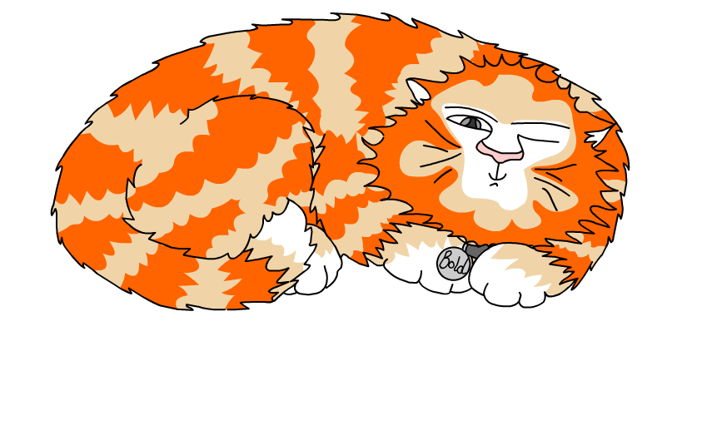
Explore more Hamilton Trust Learning Materials at https://wrht.org.uk/hamilton/ .

