Slide 1

The Lost Thing
Parenthesis

Slide 2

Parenthesis
Parenthesis is extra information added into a complete sentence.
The original sentence makes sense without it.
The extra information can be separated using commas, brackets or dashes.
complete sentence
The Lost Thing was found on the beach.
The Lost Thing, a strange red metal creature, was found on the beach.
extra added information
Commas are most commonly used to separate a parenthesis. They don't draw much attention from the reader.

Slide 3
Parenthesis
There are 3 ways to separate the extra information,
commas, brackets and dashes.
The choice of which punctuation to use is yours, they all do the same job.
There is disagreement about when the different punctuation should be used but, in general, you can think of commas, brackets, and dashes as being on a line from quite low key to quite high visibility! Commas don’t break up the sentence much, brackets break it up a bit, and dashes really do disrupt the sentence.
commas are the quiet conversational voice of a friend walking by your desk
brackets are the behind your hand whisper of an aside
dashes are the shout of a pirate dashing into a fight

Slide 4
Parenthesis
Commas are used very often – they do not draw much attention
to the extra information and hardly break up the sentence at all.
The Lost Thing sat surrounded by people.
complete sentence
The Lost Thing sat, looking out of place, surrounded by people.
extra added information

Slide 5
Parenthesis
Commas are used very often – they do not draw much attention
to the extra information and hardly break up the sentence at all.
complete sentence
Choose some extra information
about The Lost Thing.
The Lost Thing turned out to be quite friendly.
for all its strange appearance
Add it using commas.
when I spoke to it
even though it scared me
Possible answer
The Lost Thing, when I spoke to it, turned out to be quite friendly.

Slide 6
Parenthesis
Brackets are used to draw more attention to the additional information. The reader knows that they are being told something extra.
The Lost Thing sat on the roof with us.
complete sentence
The Lost Thing (making itself at home) sat on the roof with us.
extra added information
The writer might want to draw attention to important or funny extra information.
The Lost Thing (looking like a giant tea-pot) sat on the roof with us.

Slide 7
Parenthesis
Brackets are used to draw more attention to the additional information. The reader knows that they are being told something extra.
Choose some extra information
about The Lost Thing.
The Lost Thing stayed in the shed.
now full of food
Add it using brackets.
after having eaten
who still seemed sad
The Lost Thing (now full of food) stayed in the shed.
Possible answer

Slide 8
Parenthesis
Dashes are commonly used in informal writing. They break up the sentence more than commas or brackets, and therefore draw attention to the extra information.
complete sentence
People walked past The Lost Thing without a second glance .
People walked past The Lost Thing—as it clanked and creaked— without a second glance.
extra added information

Slide 9
Parenthesis
Dashes are commonly used in informal writing. They break up the sentence more than commas or brackets, and therefore draw
attention to the extra information.
Choose some extra information
about The Lost Thing.
The Lost Thing looked sad as we waited.
getting on my nerves a bit
Add it using dashes.
whatever on earth it was
my new best friend
Possible answer
The Lost Thing —my new best friend— looked sad as we waited.

Slide 10
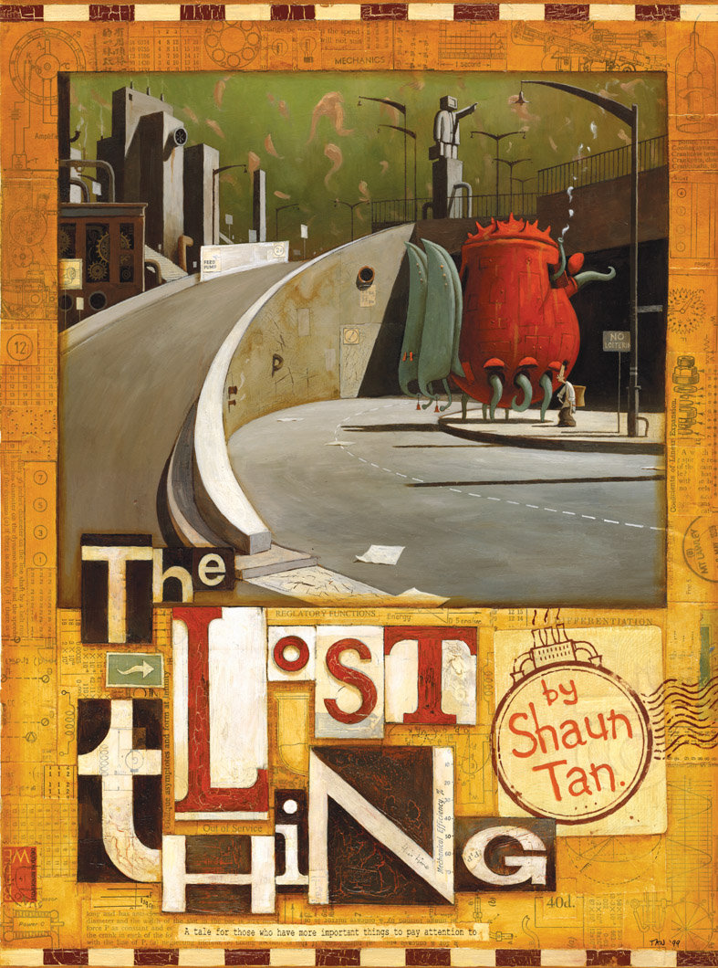
Parenthesis
To add parenthesis (extra information) to a sentence, we can use commas, brackets or dashes.
Each indicates that we are telling the reader something extra!
Not drawing much attention to the extra information
The Lost Thing is often on my mind.
Drawing lots of attention to the extra information
Drawing more attention to it
The Lost Thing, though I’ve not seen it since, is often on my mind.
The Lost Thing (my forever friend) is often on my mind.
The Lost Thing —that weird red teapot—is often on my mind.
When using parenthesis, it’s your choice how much attention you want to draw to the extra information.

Slide 11

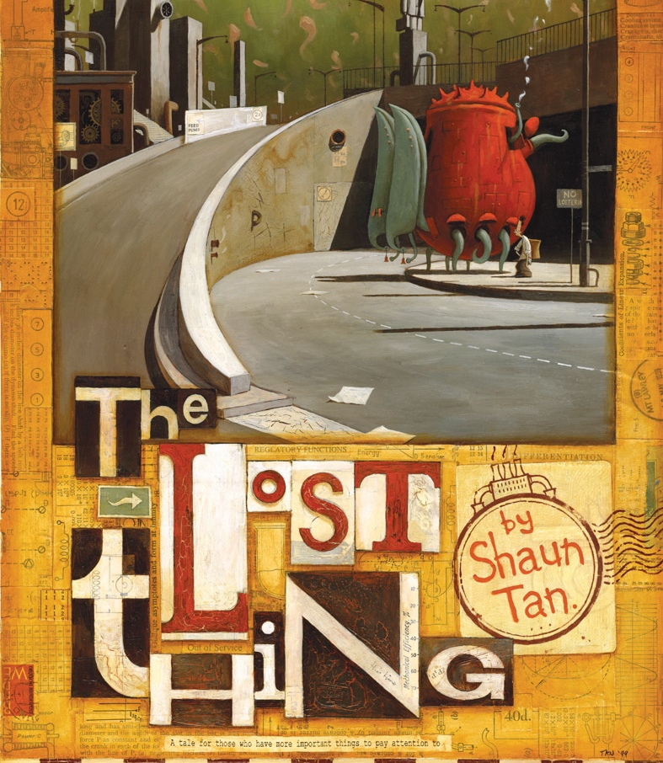

Explore more Hamilton Trust Learning Materials at https://wrht.org.uk/hamilton/ .

