Slide 1


Understand grouping as one model of division.
How many groups of 5 can we make from these 20 counters?
We had 20; we put them in groups of 5.
How many groups do we have?
Are there enough for another group of 5?
Are there enough for another group of 5?
Are there enough for another group of 5?
Twenty grouped in 5s makes 4 groups. We can record the grouping like this:
20 ÷ 5 = 4

Slide 2
Understand grouping as one model of division.
How many groups of 5 in
this line of 15 counters?
☐ x 5 = 15?
3
3 groups of 5 makes 15. 15 ÷ 5 = 3

Slide 3
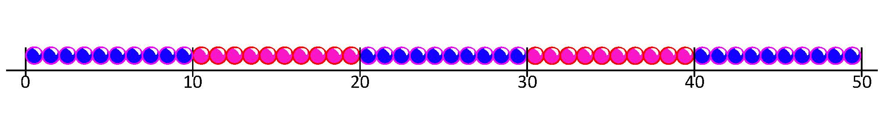
Understand grouping as one model of division.
How many groups of 10 are there in 30?
☐ x 10 = 30?
3 groups of 10 makes 30. 30 ÷ 10 = 3

Slide 4
Understand grouping as one model of division. Begin to understand that there may be ‘some left over’ after division.
How many groups of 10 in this line of 23 counters?
We can make 2 groups, but we’ve got some left over.
How many?
23 ÷ 10 =
2 groups and 3 left over

Slide 5
Understand grouping as one model of division. Begin to understand that there may be ‘some left over’ after division.
How many groups of 5 in this line of 23 counters?
Sometimes this happens when we want groups of 5 for PE…
If we haven’t got a multiple of 5, all the groups can’t be 5s, so we have some left over!
23 ÷ 5 =
4 groups and 3 left over

