Slide 1

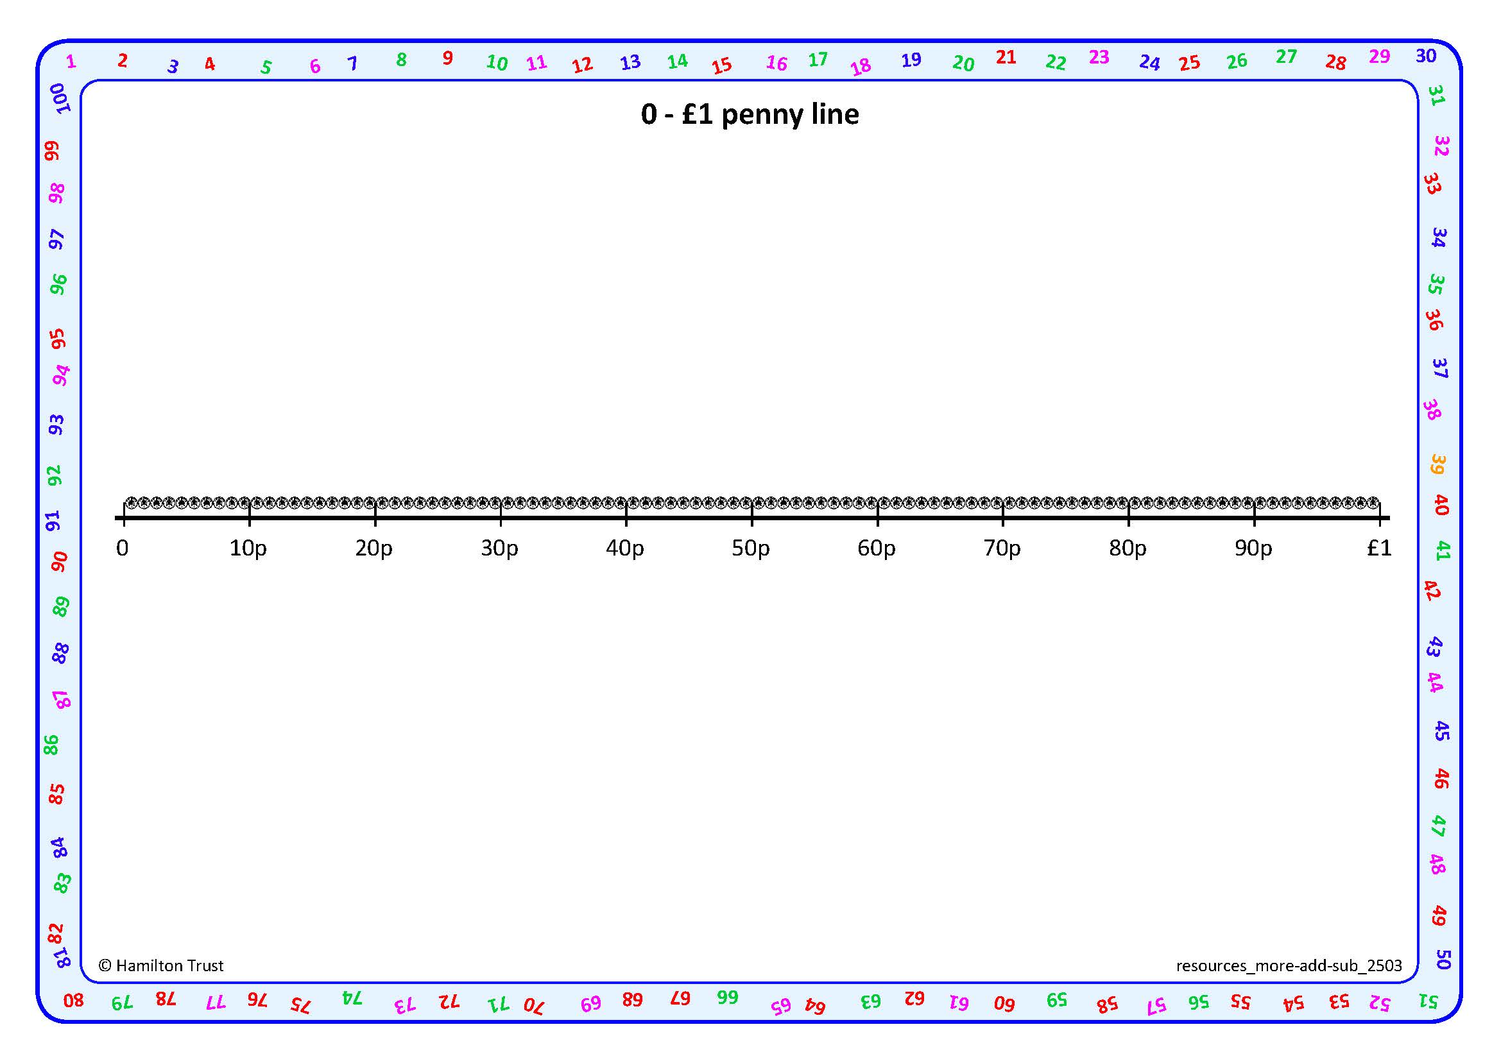

Subtract 2-digit amounts of money by counting up.
I have 52p and want to spend 47p on a can of soup.
How much will I have left?
Let’s mark 47p and 52p on our penny number line.
3
2
47p
52p
What is the difference between 47 and 50?
What is the difference between 50 and 52?
How much money is left? What subtraction number sentence can we write?
52p - 47p = 5p
52p subtract 47p equals 5p.

Slide 2
Subtract by counting up (larger gaps).
3p
10p
2p
47p
62p
I have 62p and want to spend 47p on a drink.
How much will I have left?
What is the difference between 47p and 50p ?
We had to do 3 jumps! Let’s add them all to find how much money is left.
Let’s mark 47p and 62p on the penny number line and count up to find the difference.
What is the difference between 50p and 60p ?
10p + 3p + 2p = ?
What is the difference between 60p and 62p ?
62p - 47p = 15p

Slide 3


Subtract by counting up (larger gaps).
3
10
1
57
71
Let’s find 71 - 57 on this landmarked number line.
What is the difference between 57 and 60?
First mark 57 and 71 on the number line; then use Frog to count up to find the difference.
Let’s add all the jumps to find the difference.
What is the difference between 60 and 70 ?
10 + 3 + 1 = ?
What is the difference between 70 and 71 ?
71 - 57 = 14

Slide 4
Subtract by counting up (larger gaps).
2
10
5
68
70
80
85
Let’s calculate
85 – 68.
We do not need the whole of the 0–100 line, just the part between 68 and 85.
How far from 68 to 70?
Let’s add all the jumps to find the difference between 68 and 85.
How far from 70 to 80?
We can draw our own line and mark 68 and 85 and the 10s numbers between them.
10 + 5 + 2 = ?
How far from 80 to 85?
85 - 68 = 17

